Slide 1
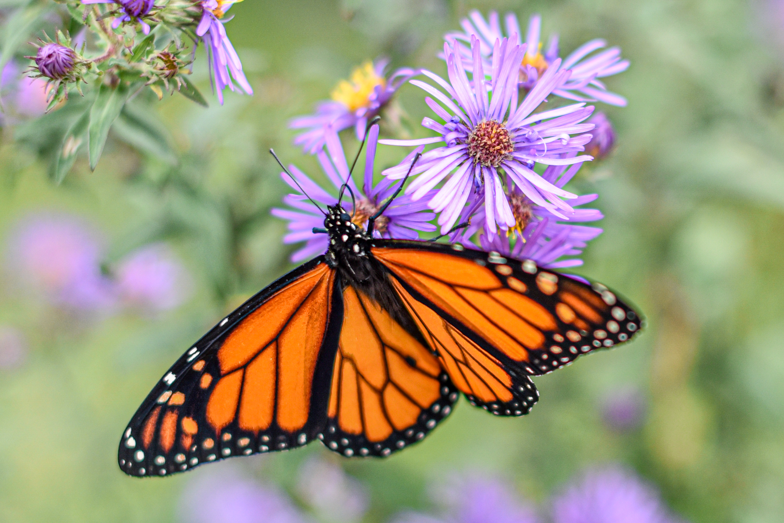
Topics in Distributed Learning Technology
Athabasca University
Faculty of Health Disciplines Professional Development Workshop
Stephen Downes September 25, 2019

Slide 2
Agenda
The Learning Context
  Critical Literacies
  Open Pedagogy
Data and Cloud
  Content: developing an understanding of dynamic and fluid data networks, how to access open data, and how to work with data in cloud-based resources.
  Hands-on activities: access to and use of open data; exploration of a cloud environment.
Graph and Resources
  Content: new types of graph-based resources, including distributed knowledge networks.
  Hands-on activities: experience developing graphs, use of distributed resources such as Jupyter Notebooks.
Identity and Recognition
  Content: how we know who someone is, how we project ourselves on the internet, and how we can be safe and secure; how we know what someone has learned.
  Hands-on activities: creation of &#39;identity graphs&#39;, creation of public and private keys, and creation of digital credentials
Experience, Community and Agency
  Content: how to enable learning experiences based on hands-on practice and knowledge creation sufficient to support a rapidly evolving sense of community based on information exchange and consensus.
Actionable Practices
  Community network development and management, and
  Personal learning management and support

Slide 3
A Word of Advice…
It’s the experience
Not the content

Slide 4
Perspectives
 | Philosophy My degrees are in philosophy and I specialized in philosophies of mind, science, knowledge and logic. I ask questions about the bases for arguments and claims, look for presumptions about meaning and value, and consider ways of sensing, comprehending and knowing. |  | Education I am interested in the processes of learning, inference and discovery on a practical level. I ask what it is to learn – why and how people learn - and what are the conditions for best learning outcomes. I am focused on learning experience and personal agency.
 | Computing I took a few courses but have mostly taught myself computer programming over the years, learning a number of languages, and building websites, content management systems, and learning technology. I think of programming as a means of expression. |  | Media Since my days as a newspaper carrier to my involvement in student journalism to my work today in online media I have worked on new and better means of conveying information, illustration and photography, community-building and interactivity.
ψ
%
:
Ξ

Slide 5
Perspectives
?
?
?
?

Slide 6
Your Notes / Our Notes
Edit this document or make your own copy:
http://bit.ly/au-workshop

Slide 7

The Long Game
Give your table group a name
You will need a flag or a coat of arms
What kind of group are you? (Nation, linguistic, family, religion, company, etc?)
Who is your leader? What are they? (President, Imam, CEO, Monarch, Godfather, , etc.?)
What do you believe? (E.g., “Grease is the word”)
How do you recognie each other (Handshape, greeting, clothing?)

Slide 8

The Learning Context

Slide 9
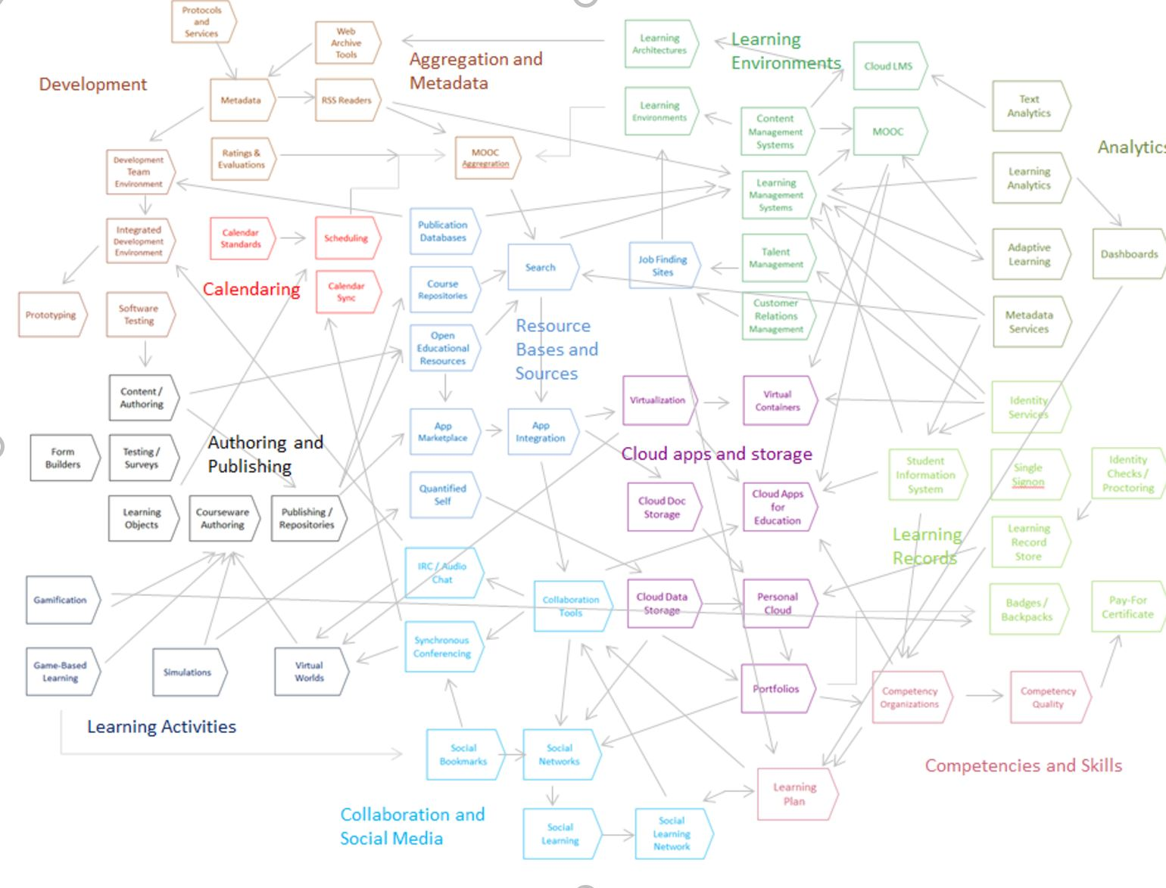
State of the Art

Slide 10
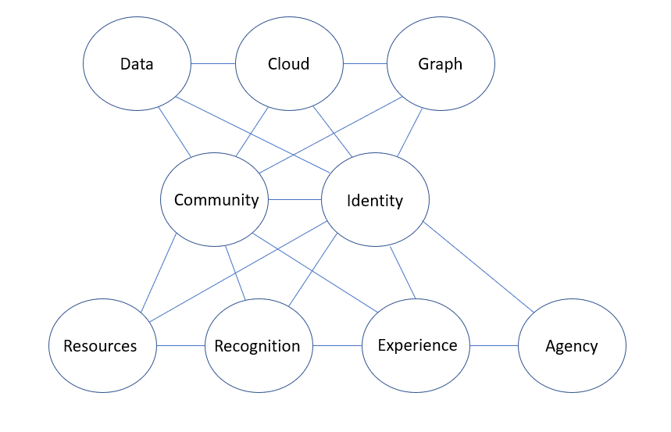
Core Concepts

Slide 11
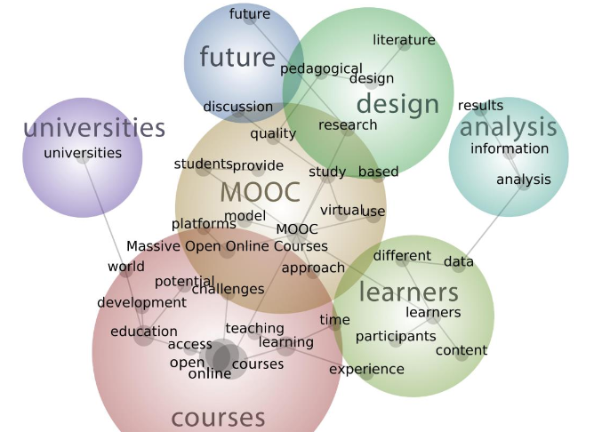
Open Online Learning
Zawacki-Richter, Bozkurt, Alturki,and Aldraiweesh. 2018. What Research Says About MOOCs –An Explorative Content Analysis. InternationalReview of Research in Open andDistributed LearningVolume 19, Number 1. https://files.eric.ed.gov/fulltext/EJ1174059.pdf

Slide 12



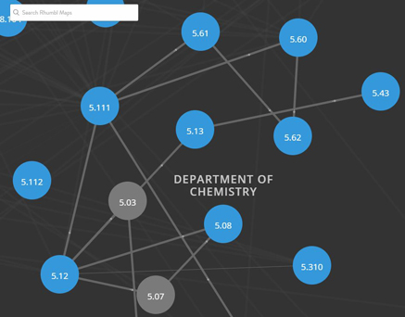


OER Repositories
https://www.oercommons.org/
https://openstax.org/
OERs are now widely available through subject-specific libraries with provisions for authoring as well
https://ocw.mit.edu/

Slide 13
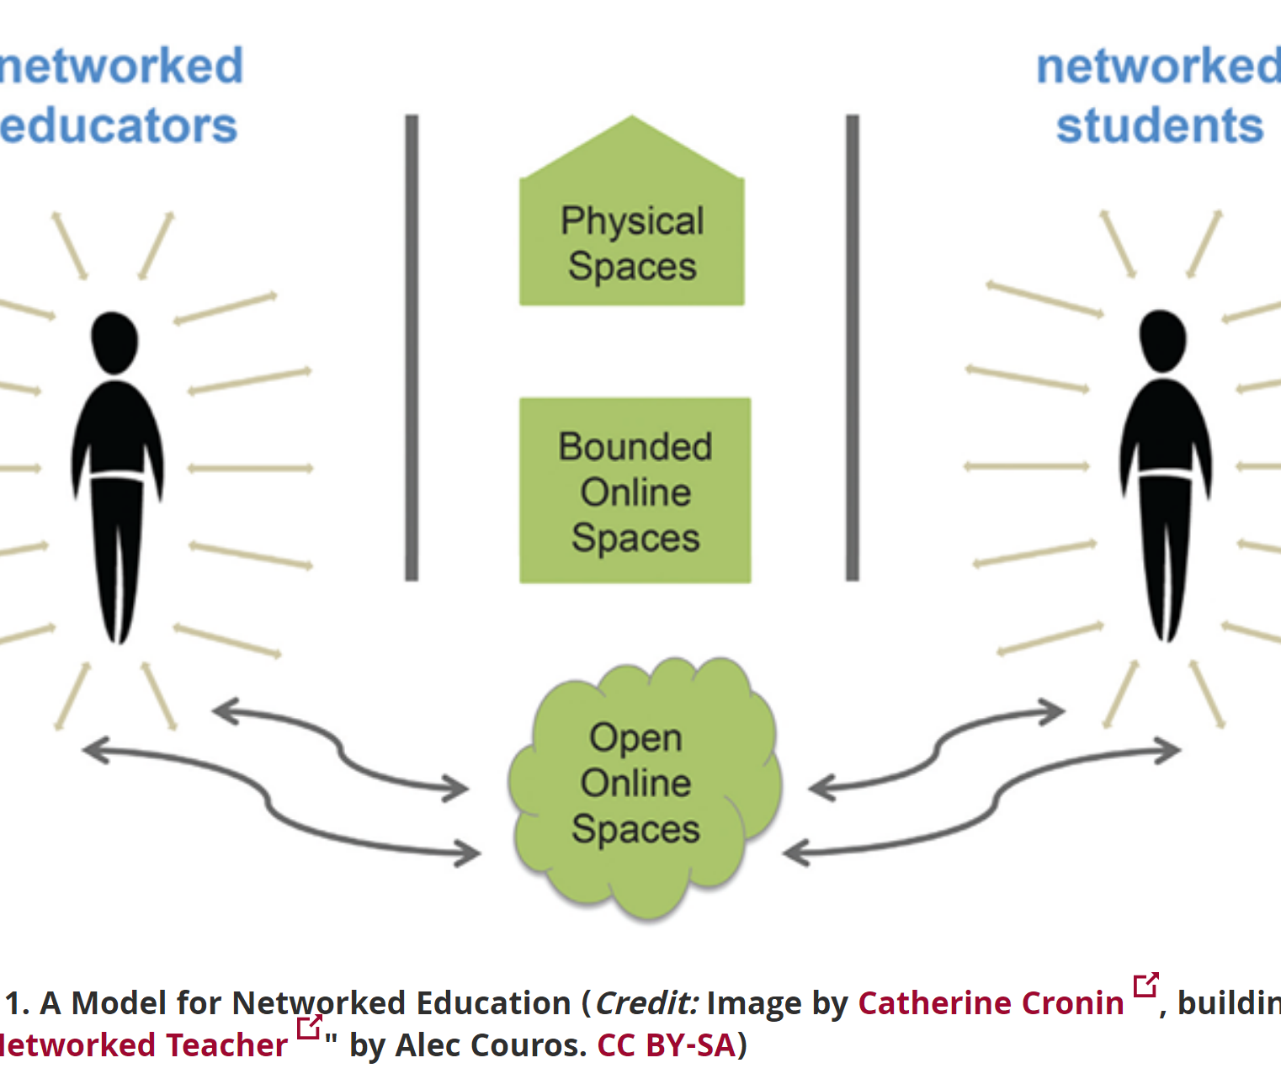
Open Resources, Open Teaching
Open Pedagogy – Using OER to Chane How We Teach – Heather Ross https://words.usask.ca/gmcte/2016/09/26/open-pedagogy-using-oer-to-change-how-we-teach/
Open Education, Open Questions – Catherine Cronin https://er.educause.edu/articles/2017/10/open-education-open-questions
  “The use of open practices by learners and educators is complex, personal, and contextual; it is also continually negotiated.”

Slide 14
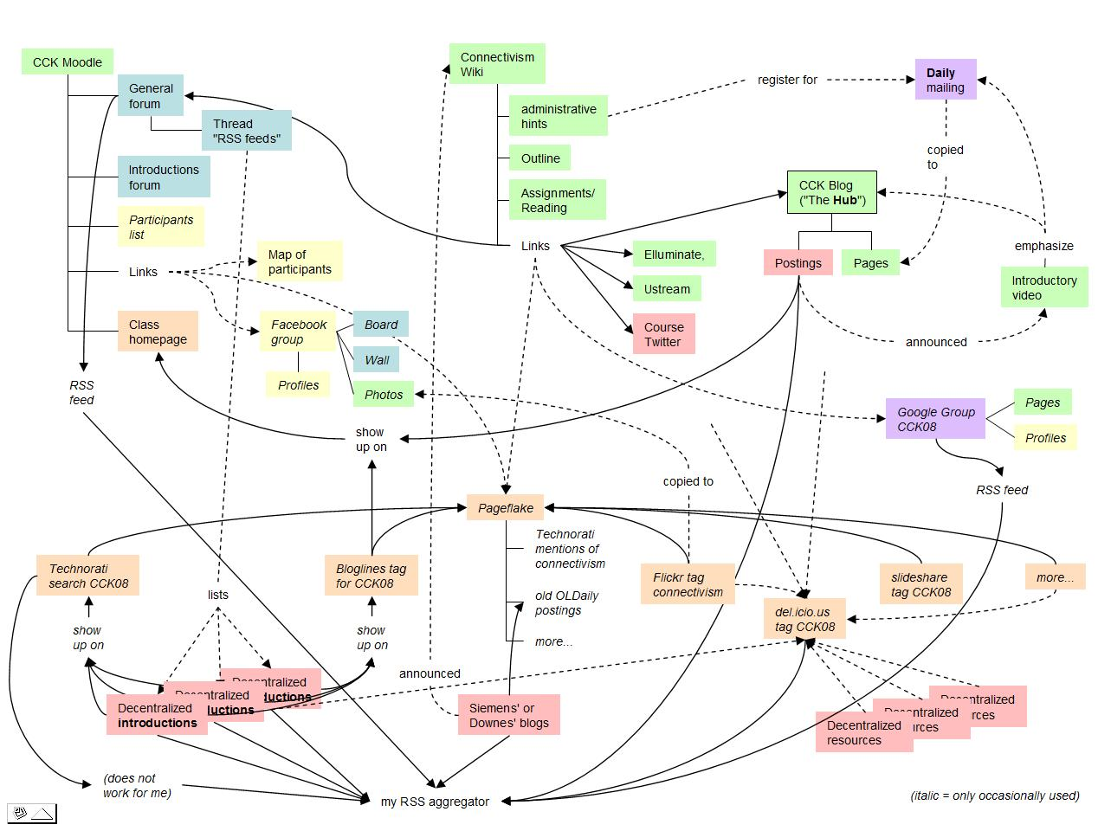
Origins of the MOOC
The idea was to recreate the concept of the 'course of lectures' from the traditional university. Students are responsible for their own education, often forming communities or societies to collaborate. Students would bring in additional resources, contribute to the discussions, and over time, develop their own thoughts and theses.

Slide 15
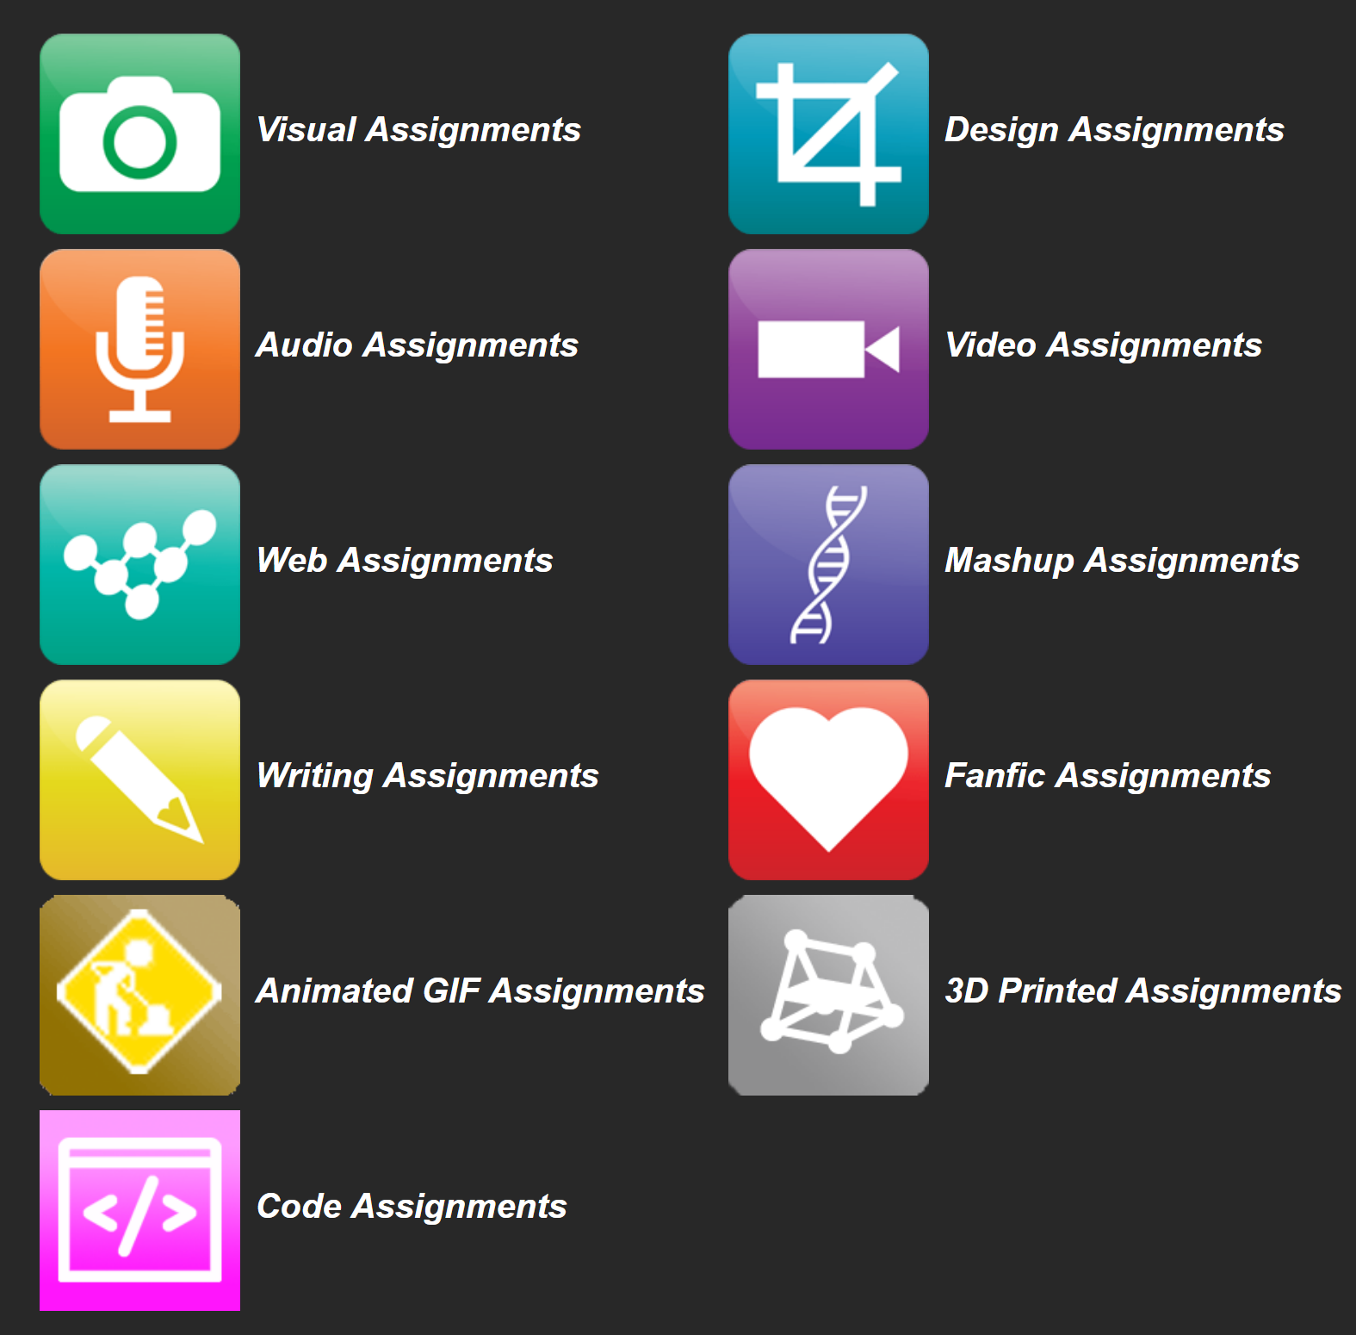

OERs as Student Production
DS106 – assignment bank http://assignments.ds106.us/
Domain of One’s Own - https://reclaimhosting.com/domain-of-ones-own/
Creation of OERs through ‘renewable assignments’ – Christina Hendricks http://flexible.learning.ubc.ca/news-events/renewable-assignments-student-work-adding-value-to-the-world/
Introduction to Philosophy: Philosophy of Mind
https://press.rebus.community/intro-to-phil-of-mind

Slide 16
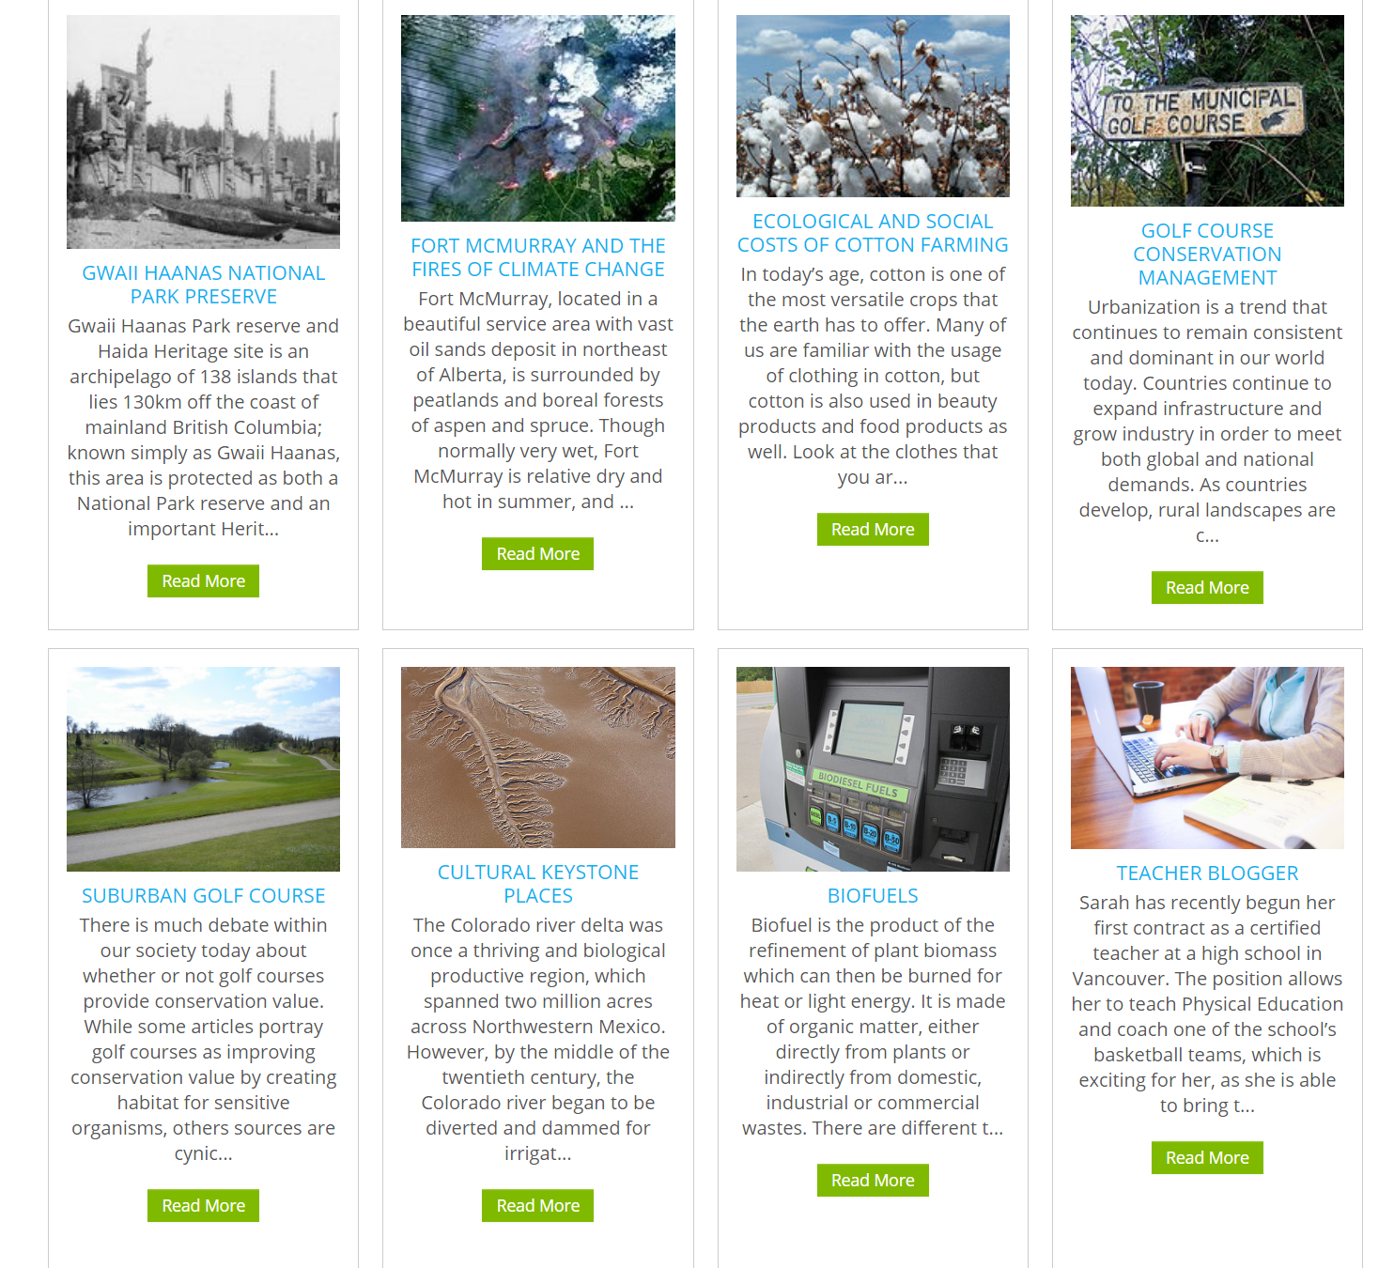
Open Case Studies
case studies that can be used by anyone, at UBC or elsewhere.
Many focus on topics in sustainability
cases on this site are open educational resources: they have an open license to allow for revision and reuse of the cases in other courses and contexts
Quoted from: http://cases.open.ubc.ca/

Slide 17
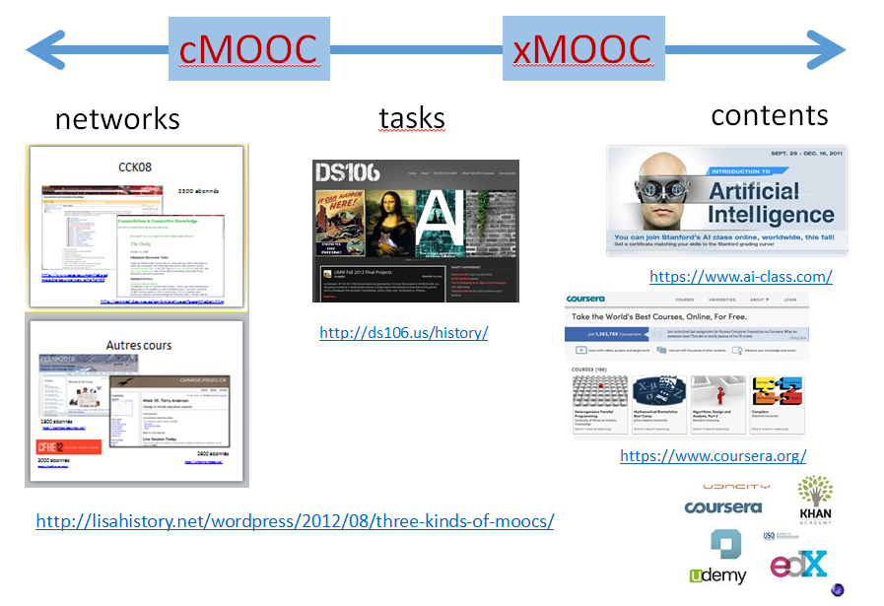
Adaptations: xMOOC and Beyond
The xMOOCs which followed (Stanford AI, EdX, etc
- they depended mostly on pre-recorded videos for content
- they dispensed pretty much entirely with the community
- the assignments were created centrally and became the means of assessment
- they commercialized and monetized the course (as opposed to the education)
Notes:
http://lisahistory.net/wordpress/2012/08/three-kinds-of-moocs/
http://ds106.us/history/
https://www.ai-class.com/
https://www.coursera.org/

Slide 18
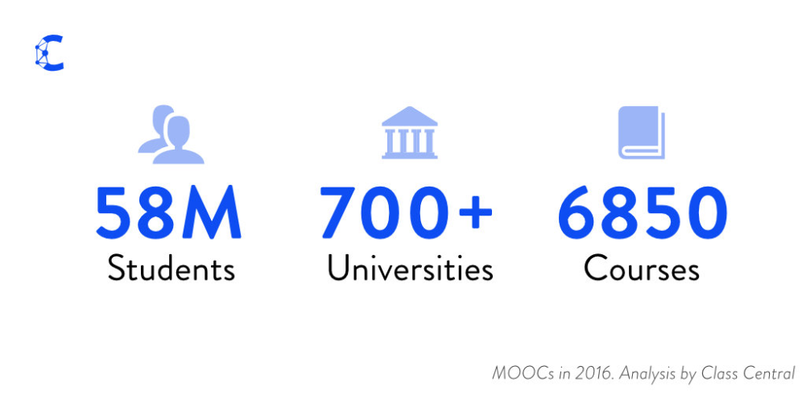
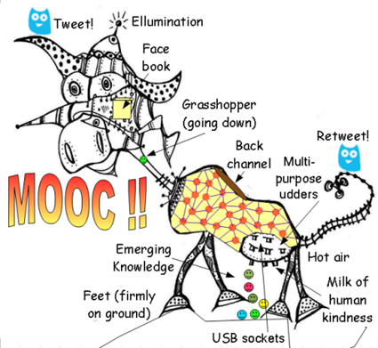
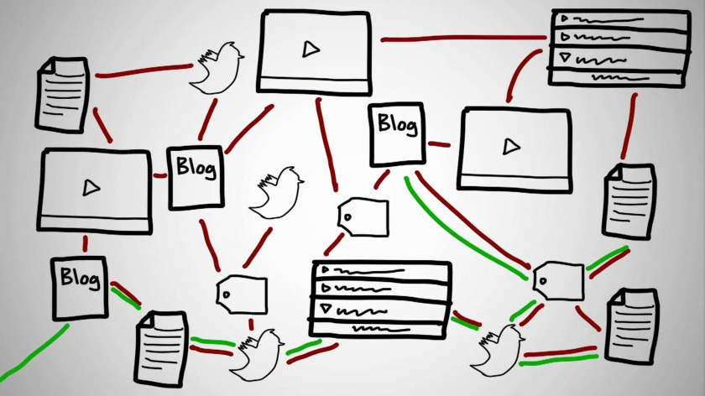
The MOOC Today
In 2016, “23 million people worldwide registered for a MOOC for the first time ever... This makes the total number of students who signed up for at least one MOOC estimated to be 58 million. 2,600+ new courses (vs. 1800 last year) were announced, taking the total number of courses to 6,850 from over 700 universities.” (Class Central)
Notes:
https://www.class-central.com/report/mooc-stats-2016/23 million people worldwide registered for a MOOC for the first time ever, according to data collected by Class Central. This makes the total number of students who signed up for at least one MOOC estimated to be 58 million.

Slide 19
Open Pedagogy
Participatory | Interacting via social networks and mobile apps
People and trust | Develop trust, confidence and openness working with others
Innovation & creativity | Encourage spontaneous innovation and creativity
Sharing ideas and resources | Share freely to disseminate ideas and thoughts
Connected community | Participate in a community of practice
Learner-generated | Facilitate learner contributions to OER
Reflective practice | Create opportunities for dialogue and reflection
Peer review | Contribute to an open critique of scholarship
Gráinne Conole. 2015. MOOCs as disruptive technologies: strategies for enhancing the learner experience and quality of MOOCs. Revista de Educación a Distancia. Número 39. http://www.um.es/ead/red/39
Bronwyn Hegarty. 2015. Attributes of Open Pedagogy: A Model for Using Open Educational Resources. Educational Technology, July/August, 2015. https://upload.wikimedia.org/wikipedia/commons/c/ca/Ed_Tech_Hegarty_2015_article_attributes_of_open_pedagogy.pdf

Slide 20

Critical Literacies

Slide 21
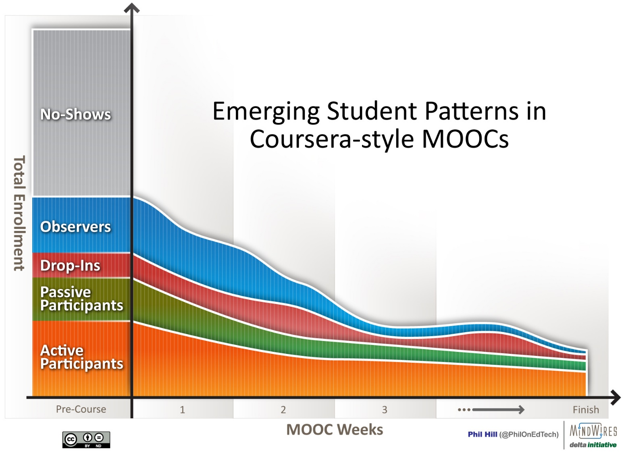
Criticisms of the MOOCs
MOOCs have face a storm of criticism – unprepared students, bad pedagogy, lack of educational standards, a failure to engage, and ultimately, dropouts.
Image: http://mfeldstein.com/emerging-student-patterns-in-moocs-a-revised-graphical-view/
Notes:
Lack of preparation - Eg. The Chronicle – “Why Delusions to Educate the world are absurd” - http://chronicle.com/blogs/worldwise/a-mooc-delusion-why-visions-to-educate-the-world-are-absurd/32599 – “lack the willingness to consider seriously what happens when thousands of students constituting a vast spectrum of proficiency levels and academic backgrounds try to catch up “
Bad pedagogy – EDUCAUSE, Five Myths about MOOCs - eg. http://er.educause.edu/articles/2013/10/five-myths-about-moocs
Failure to engage, mechanistic – ibid
Bad technology – HuffPost – The MOOC Backlash - http://www.huffingtonpost.com/jonathan-haber/the-mooc-backlash-udacity_b_4339487.html
Dropouts - http://edf.stanford.edu/readings/coursera-takes-nuanced-view-mooc-dropout-rates or https://campustechnology.com/articles/2015/07/01/mit-researchers-develop-model-to-predict-mooc-dropouts.aspx

Slide 22
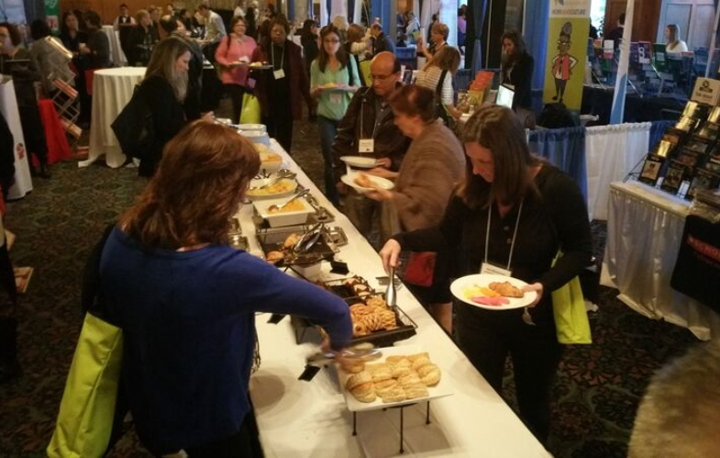
A Wider Conception of Learning
What does it mean to ‘complete’ a newspaper?
What is the proper foundation for a buffet?
Notes:
What is it to ‘complete’ a course of learning?
The presumption that there is a linear order
The presumption that there are ‘foundational’ things to learn
The case of ‘addition’ and ‘multiplication’ in Common Core
The case of ‘to be’ in language “Me Grog. Me hungry.” or “I have six years.”

Slide 23
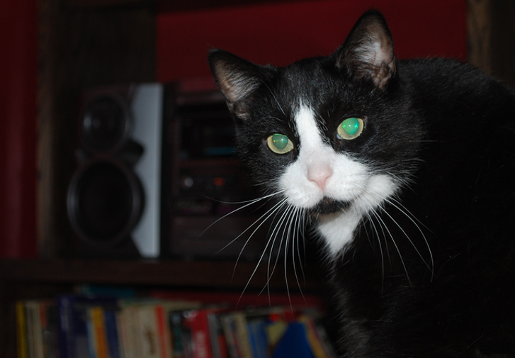
What does it mean to be literate?
Literacy
Numeracy
Financial literacy
Emotional literacy
Digital literacy
Etc. Etc.
Notes:
Go beyond traditional conceptions, conceptions like:
messages have a sender and a receiver
words get meaning from what they represent
truth is based on the real world
events have a cause, and causes can be known
science is based on forming and testing hypotheses
These, taken together, constitute, a static, linear, coherent picture of the world
Thinks we think of as ‘skills’ - performance, simulation, appropriation, etc - are actually languages and should be understood in terms of these six dimensions

Slide 24
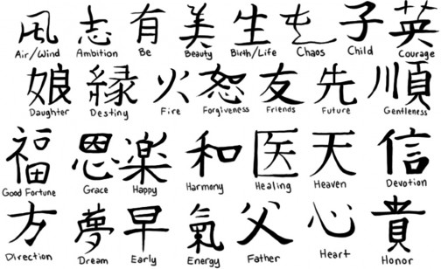
Meaning – it’s not just semantics any more
This brings us back to language – what is the ‘core’ of a language? What are the foundations?
What is the ‘core’ of a discipline – like medicine, law or physics? What are the foundations?
Image: http://www.alegoo.com/pictures7/art-tattoos-2/tattoos-with-meaning-029/
Notes:
Tarski semantics – ‘snow is white’ is true iff snow is white
Meaning as ‘standing for’ - http://emojipedia.org/
Representationalism / models / coherence / community-agreement
Meaning – vs what it’s *not* - Derrida - difference
Meaning as performative - J.L. Austin – how to do things with words
Wittgenstein – meaning as use

Slide 25
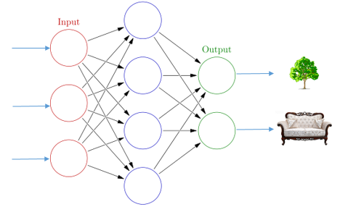
Knowledge as Recognition

Slide 26









Knowledge as Recognition

Slide 27











Knowledge as Recognition

Slide 28
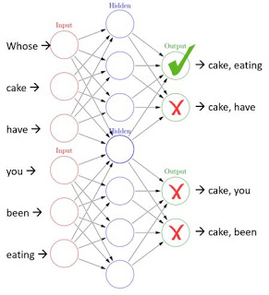
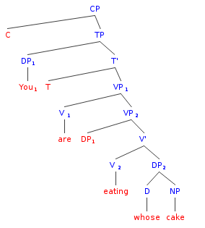
Whose cake are you eating?

Slide 29
Semantics is association
- this isn’t just a statement about language, it’s a statement
about knowledge generally
- people aren’t ‘constructing models’ in their minds, they’re
constructing them in the world – in social communities
- but if they’re learning, they’re creating associations
(which are, literally, connections between neurons)
This assertion is the core of Wittgenstein’s private language argument.

Slide 30
These connections are self-organizing
- neural networks are prediction engines
- we are constantly predicting what we expect next
- these appear as sensations (or part of sensations)
along with our other sensations
- it’s a natural process – no construction, no management
- this includes language
- mentally, a language is nothing more than a series of
shapes and sounds we read, hear and speak
- the formal properties of language (syntax, semantics, etc)
aren’t part of consciousness at all

Slide 31
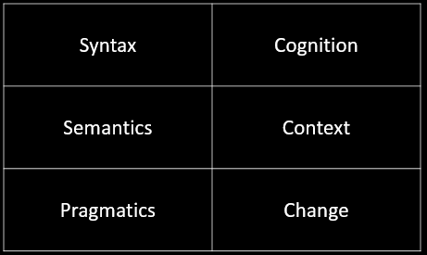
The Critical Literacies – How We Recognize
This is a frame for understanding new media – and for understanding what it is to know, learn, and understand
Notes:
Syntax, semantics, pragmatics from Morris, foundation for a theory of signs
Syntax:
Forms: archetypes? Platonic ideals?
Rules: grammar = logical syntax
Operations: procedures, motor skills
Patterns: regularities, substitutivity (eggcorns, tropes)
Similarities: Tversky - properties, etc
Semantics
Sense and reference (connotation and denotation)
- Interpretation (Eg. In probability, Carnap - logical space; Reichenbach - frequency; Ramsey - wagering / strength of belief)
- Forms of association: Hebbian, contiguity, back-prop, Boltzmann
- Decisions and decision theory: voting / consensus / emergence

Slide 32
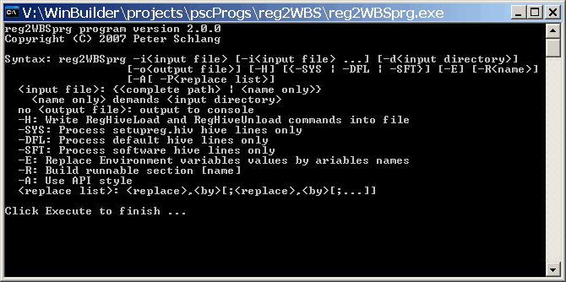
Syntax: Not just rules and grammar
Forms: archetypes? Platonic ideals?
Rules: grammar = logical syntax
Operations: procedures, motor skills
Patterns: regularities, substitutivity (eggcorns, tropes)
Similarities: Tversky - properties, etc

Slide 33
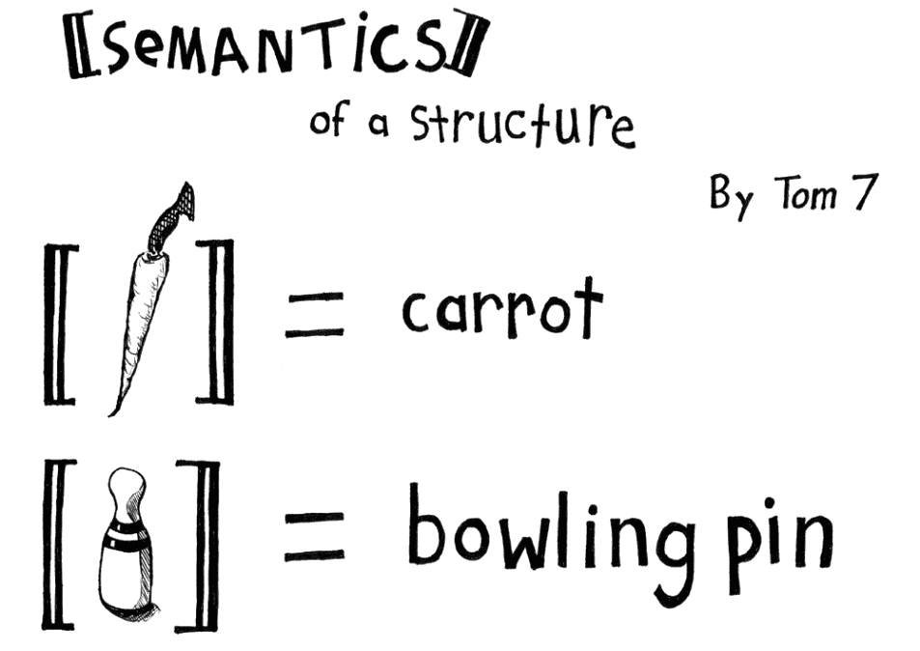
Semantics
Semantics
theories of truth / meaning / purpose / goal
- Sense and reference (connotation and denotation)
- Interpretation (Eg. In probability, Carnap - logical space; Reichenbach - frequency; Ramsey - wagering / strength of belief)
- Forms of association: Hebbian, contiguity, back-prop, Boltzmann
- Decisions and decision theory: voting / consensus / emergence
http://www.cs.cmu.edu/~tom7/csnotes/fall02/semantics.gif

Slide 34
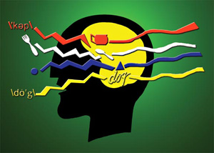
Pragmatics: use, actions, impact
Speech acts (J.L. Austin, Searle) assertives, directives, commissives, expressives, declarations (but also - harmful acts, harassment, etc)
Interrogation (Heidegger) and presupposition
Meaning (Wittgenstein - meaning is use)

Slide 35
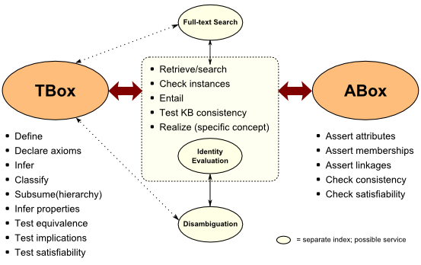
Cognition: reasoning, inference and explanation
http://www.mkbergman.com/category/description-logics/
  description - X (definite description, allegory, metaphor)
  definition - X is Y (ostensive, lexical, logical (necess. & suff conds), family resemblance - but also, identity, personal identity, etc
  argument - X therefore Y - inductive, deductive, abductive (but also: modal, probability (Bayesian), deontic (obligations), doxastic (belief), etc.)
  explanation - X because of Y (causal, statistical, chaotic/emergent)

Slide 36
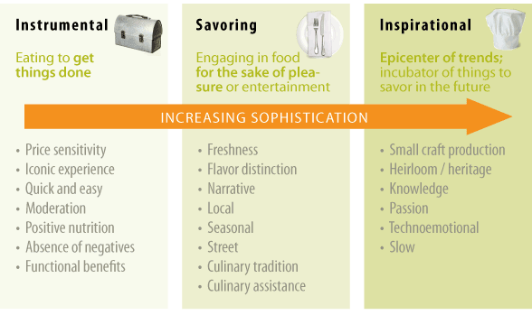
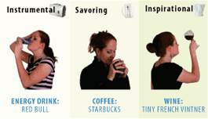
Context: placement, environment, alternatives
http://www.occasionbasedmarketing.com/what-it-is
- explanation (Hanson, van Fraassen, Heidegger)
- meaning (Quine); tense - range of possibilities
- vocabulary (Derrida); ontologies, logical space
Frames (Lakoff) and worldviews

Slide 37
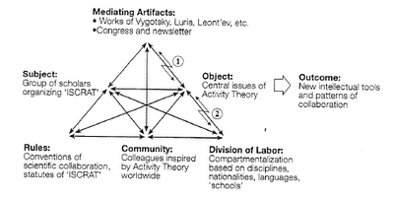
Change
relation and connection: I Ching, logical relation
flow: Hegel - historicity, directionality; McLuhan - 4 things
- progression / logic -- games, for example: quiz&points, branch-and-tree, database
- scheduling - timetabling - events; activity theory / LaaN

Slide 38
Your Critical Reflections
v
c
I
z
x
h

Slide 39

Data

Slide 40
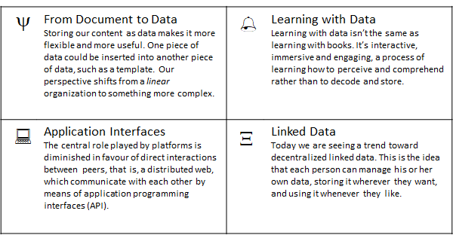
Data
This part of the workshop addresses two conceptual challenges: first, the shift in our understanding of content from documents to data; and second, the shift in our understanding of data from centralized to decentralized.

Slide 41
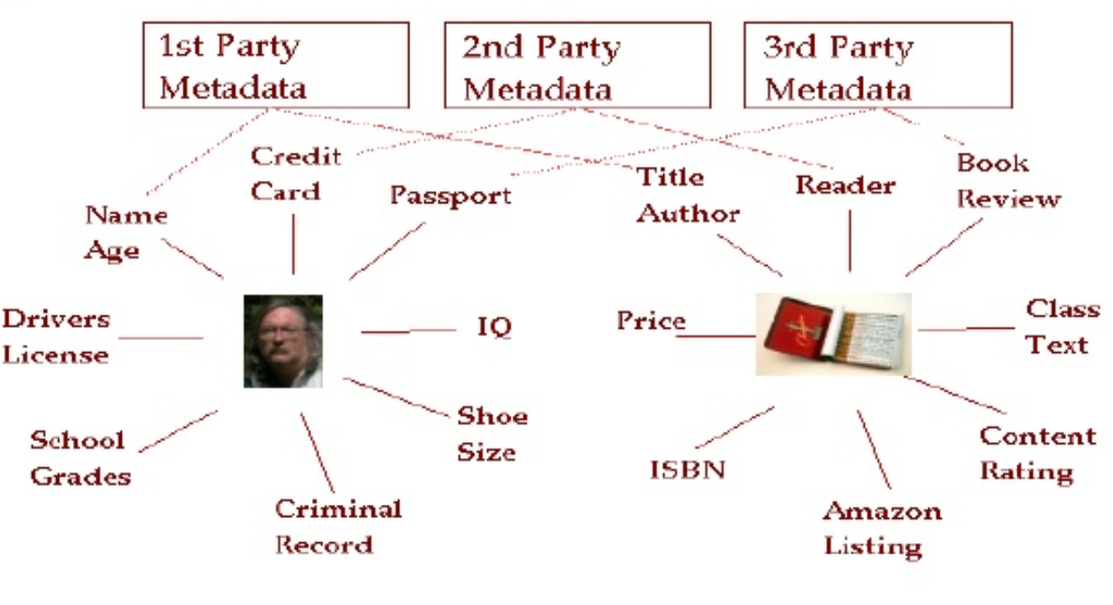
Data
Data as distributed and dynamic

Slide 42
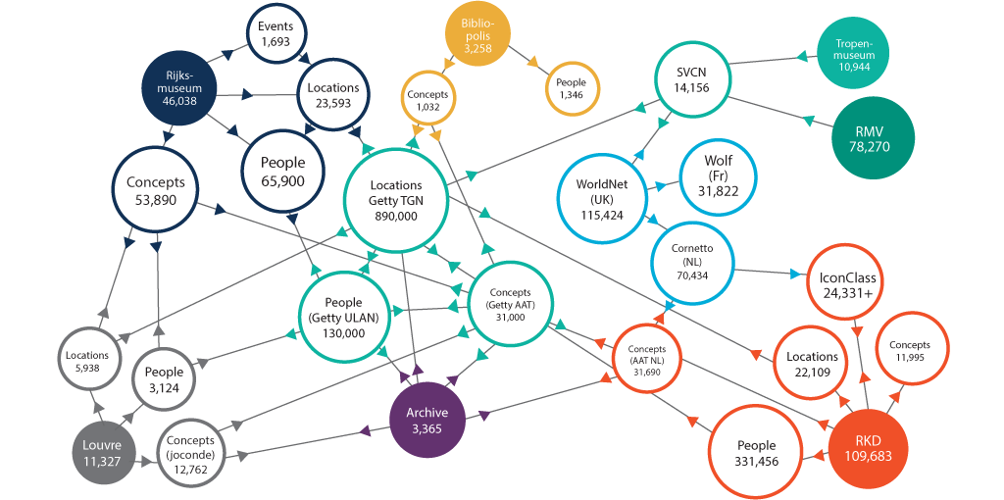
Data
The linked open data cloud
https://www.w3.org/wiki/LinkedData

Slide 43
The Linked Open Data Cloud
LinkedData is to spreadsheets and databases what the Web of hypertext documents is to word processor files.
https://lod-cloud.net/
https://ontotext.com/linked-open-data-cultural-heritage/
Notes:
https://ontotext.com/linked-open-data-cultural-heritage/
https://www.w3.org/wiki/LinkedData
https://www.w3.org/wiki/SweoIG/TaskForces/CommunityProjects/LinkingOpenData
https://communitywiki.org/wiki/MachineCodeBlocks (Lion Kimbro, 2005ish)

Slide 44
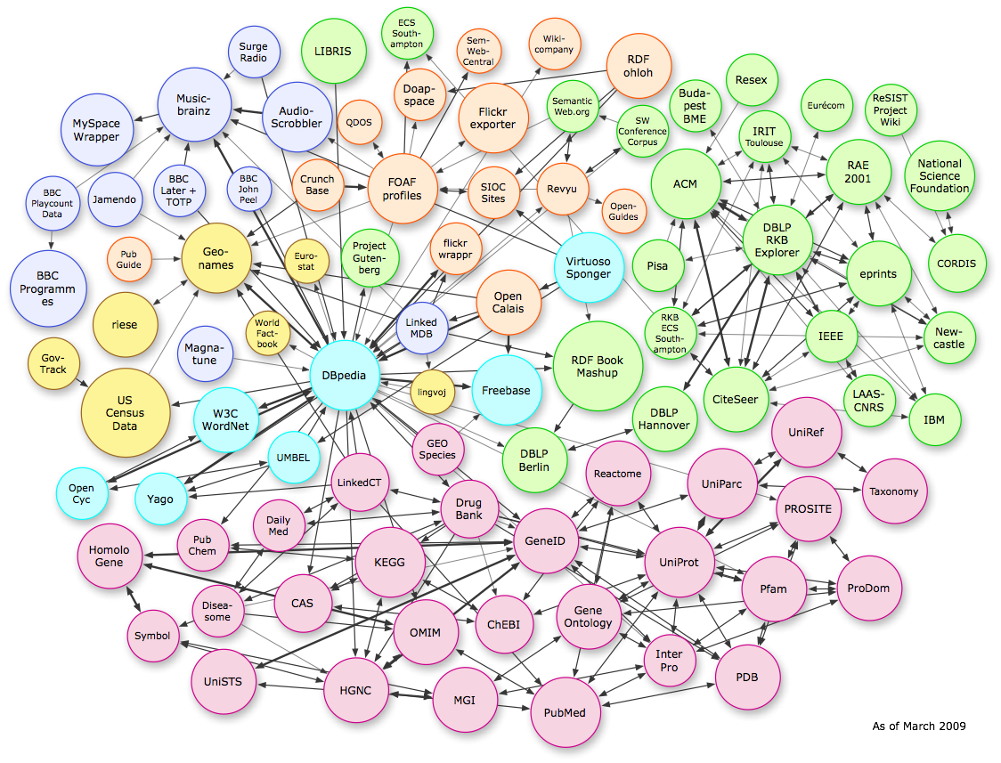
Linked Open Data
https://lod-cloud.net/
Notes:
SOLID – Tim Berners Lee

Slide 45
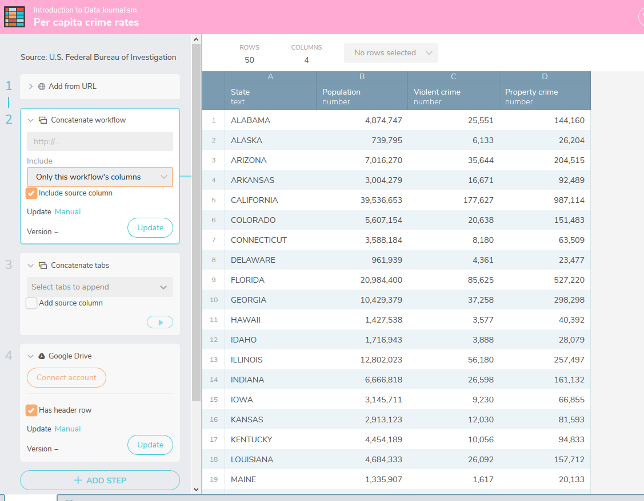
Workbench
Workbench is a free and open source data journalism platform "that enables all stages of data journalism: getting data (including scraping), then cleaning, analyzing, visualizing, and sharing it.
https://www.dataquest.io/blog/jupyter-notebook-tips-tricks-shortcuts/

Slide 46
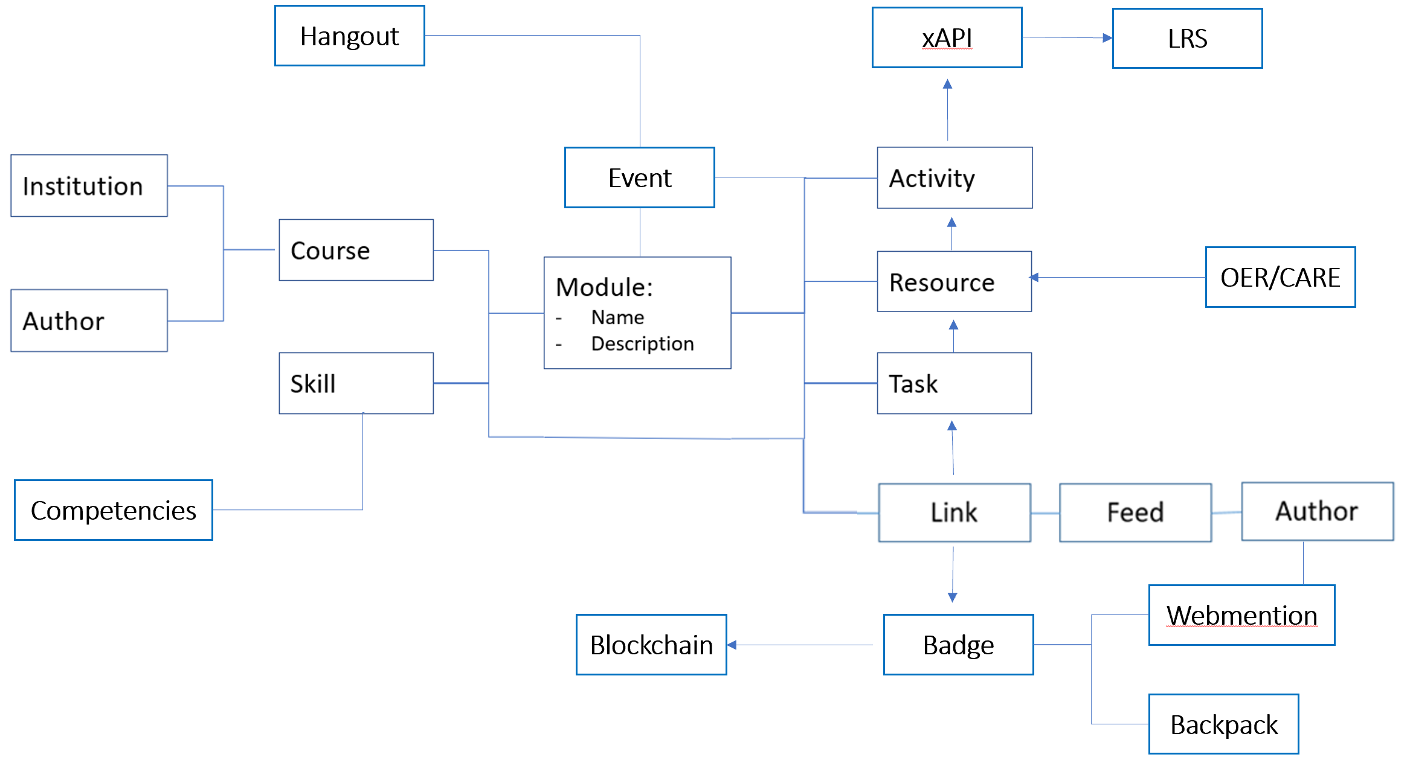
Big Idea 1: Course(?) as Open Data

Slide 47
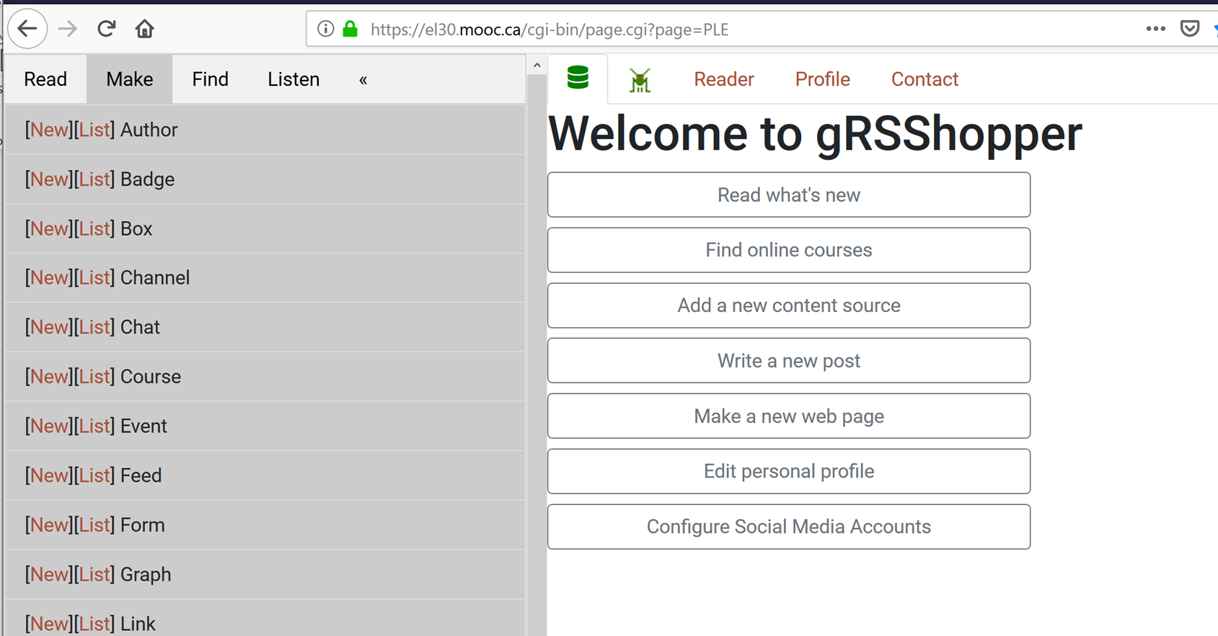
Course as Open Data in gRSShopper
https://el30.mooc.ca

Slide 48
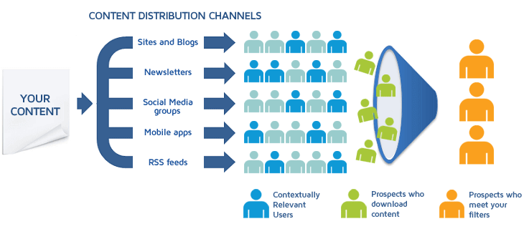
Content Syndication
Image: https://blog.izooto.com/best-content-syndication-tools/
Blog posts and comments were the core of CCK08
  gRSShopper – http://grsshopper.downes.ca
FeedPress - https://wordpress.org/plugins/feedpress/
FeedBurner - https://feedburner.google.com

Slide 49
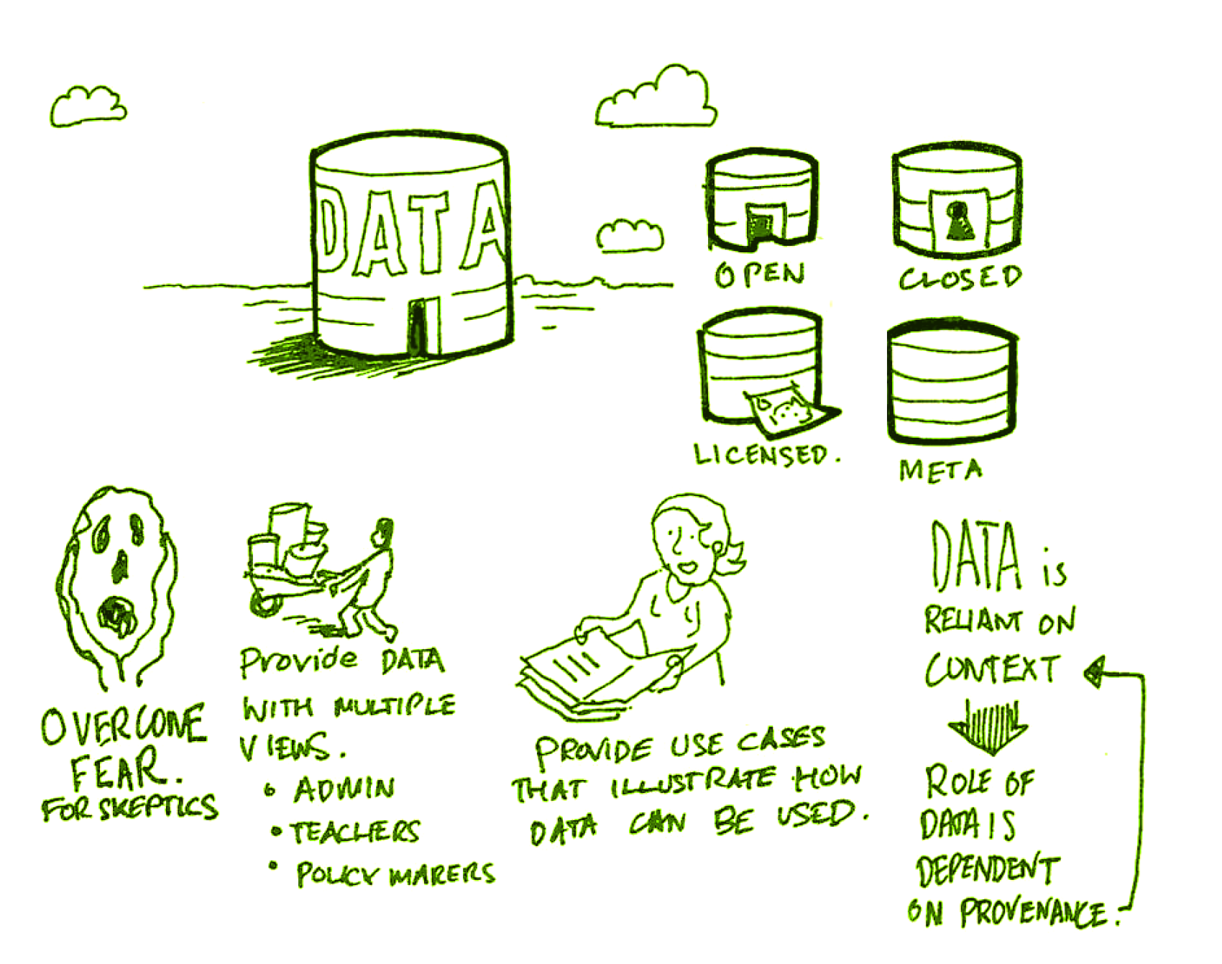
Open Data as OERs
Civic engagement in Italy
Intro programming assignments
Article-level metrics
Geodata and Land Walks in Wales
Open data for sustainable development
Atenas, J., & Havemann, L. (Eds.). (2015). Open Data as Open Educational Resources: Case studies of emerging practice. London: Open Knowledge, Open Education Working Group. http://dx.doi.org/10.6084/m9.figshare.1590031
Also: Leo Havemann, slides http://eprints.bbk.ac.uk/14750/1/Leo_ODasOER_UCL_4March16.pdf

Slide 50
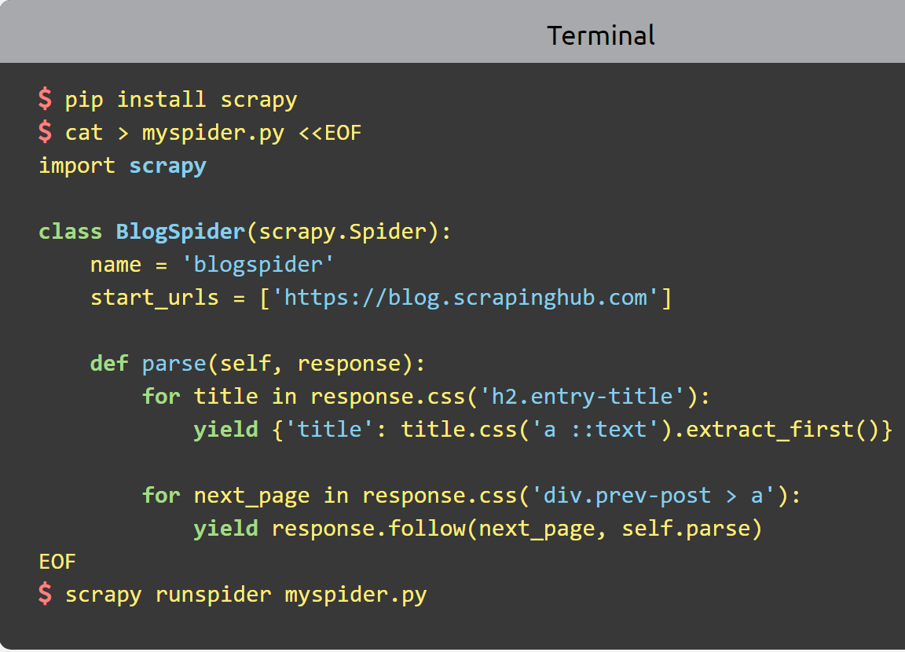
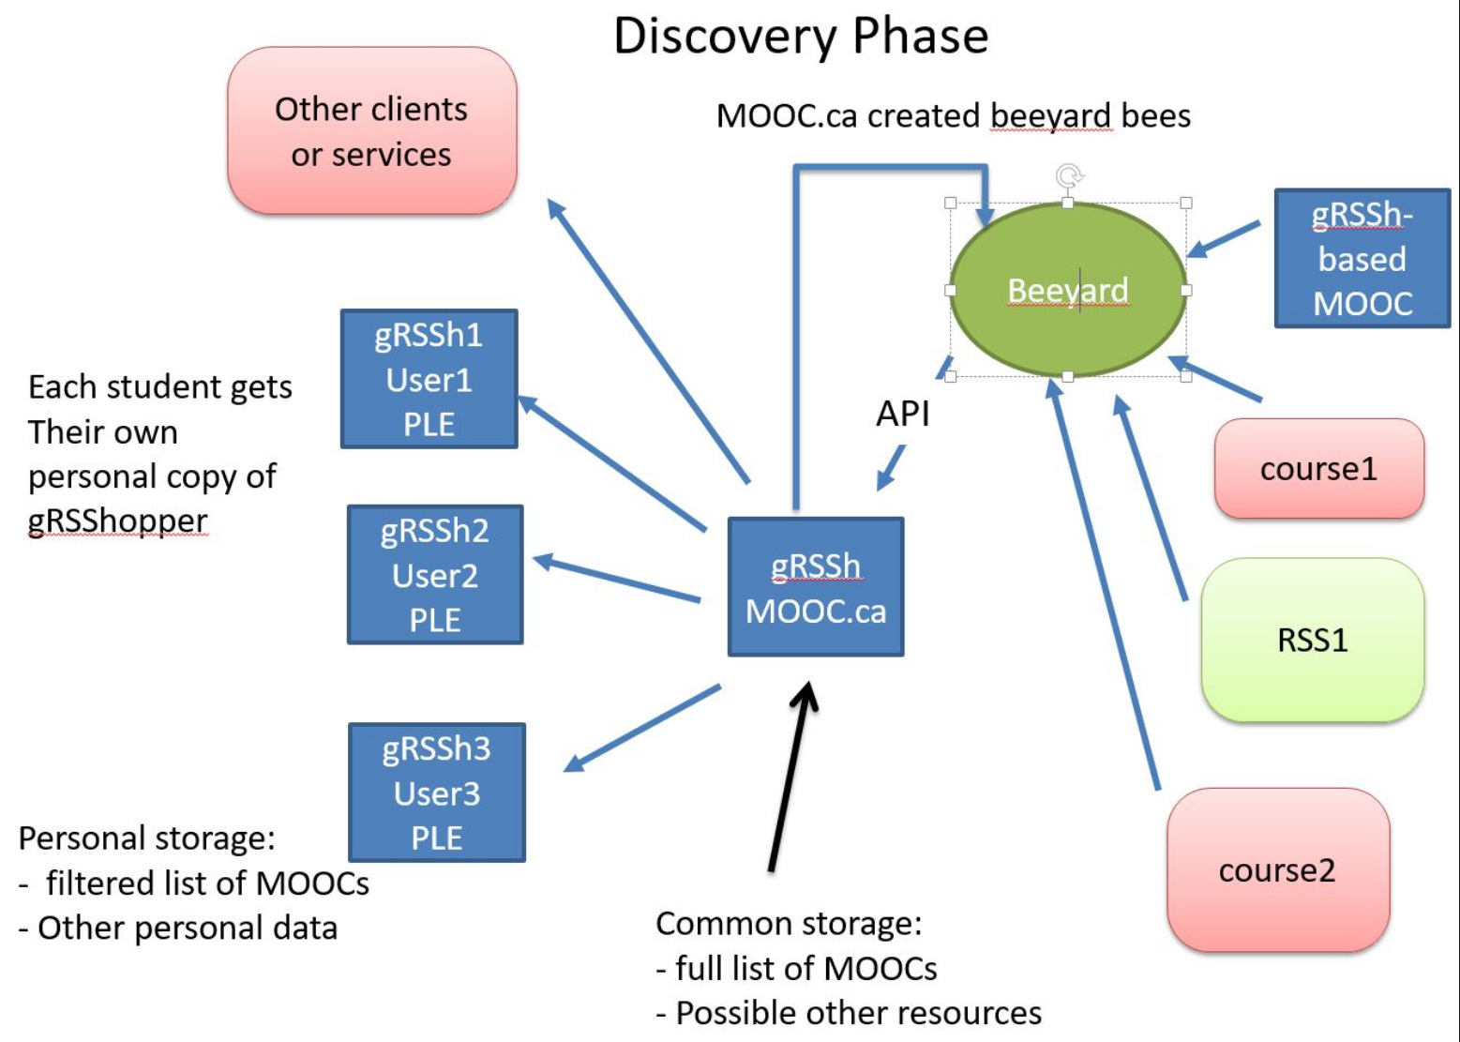
Scrapy
Python framework to aggregate and store content in RSS feeds and web sites
Forms the core of the NRC-developed ‘Beeyard’ application
https://scrapy.org/

Slide 51
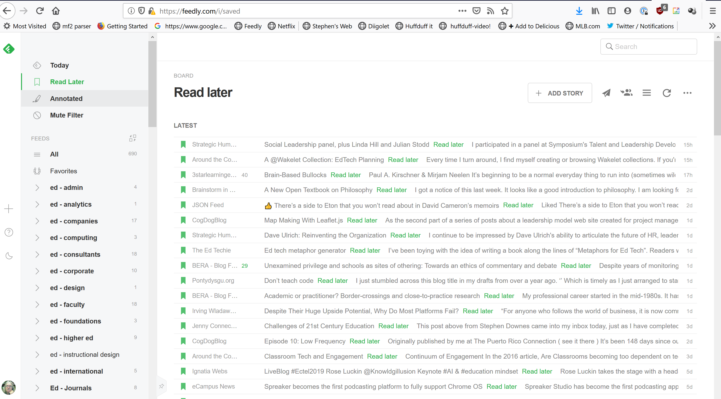
Feedly
https://feedly.com/

Slide 52
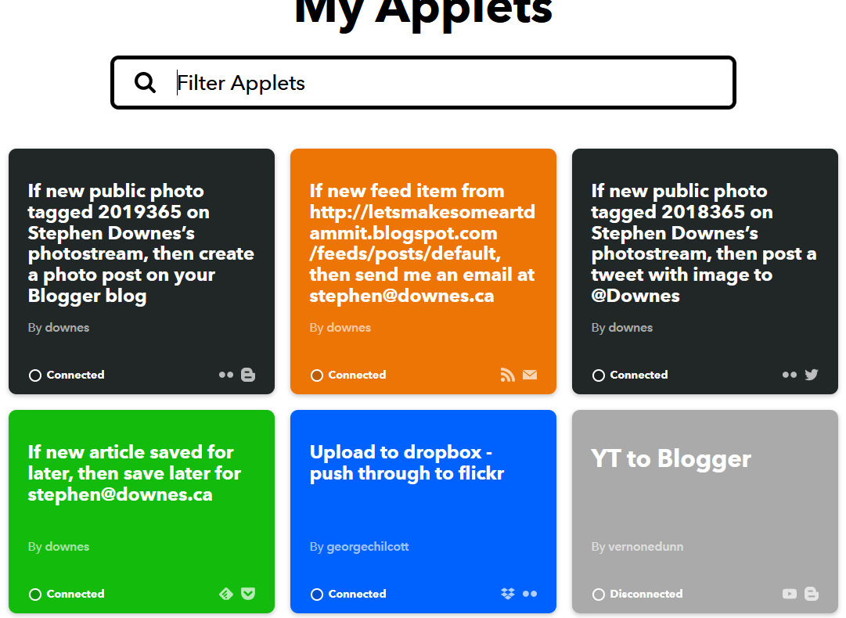
IFTTT
https://ifttt.com/

Slide 53
More
Open Government Portal: Enables access to open data on the government of Canada website. https://open.canada.ca/data/en/dataset?res_format=JSON
Solid. Tim Berners-Lee. Solid (derived from "social linked data") is a proposed set of conventions and tools for building decentralized social applications. https://solid.mit.edu/
IndieWeb. The IndieWeb is a people-focused alternative to the "corporate web". https://indieweb.org/
An Increasingly Less-Brief Guide to Mastodon. Noëlle Anthony. GitHub. https://github.com/joyeusenoelle/GuideToMastodon/

Slide 54
Activity
Make a blog
Get the RSS Feed
Subscribe to it in Feedly
Use IFTTT to send blog post to Twitter

Slide 55
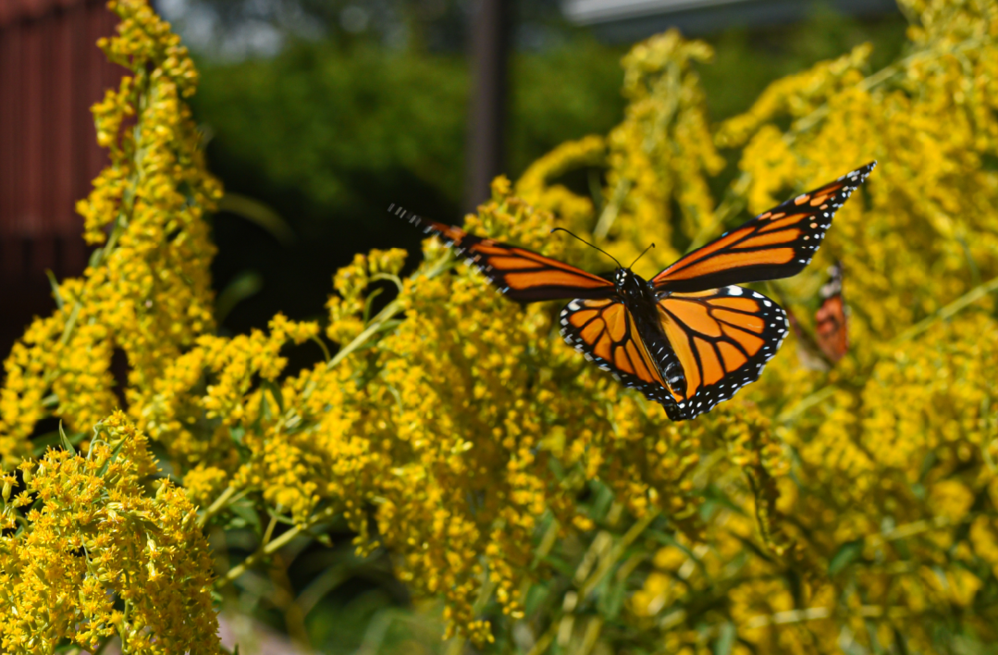
Cloud

Slide 56
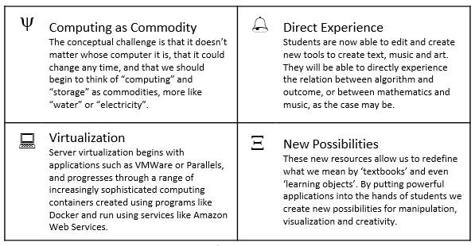
Cloud
Cloud computing involves using servers and infrastructure hosted by internet-based providers. You can then access these from any computer, and also link them together for advanced applications.:

Slide 57

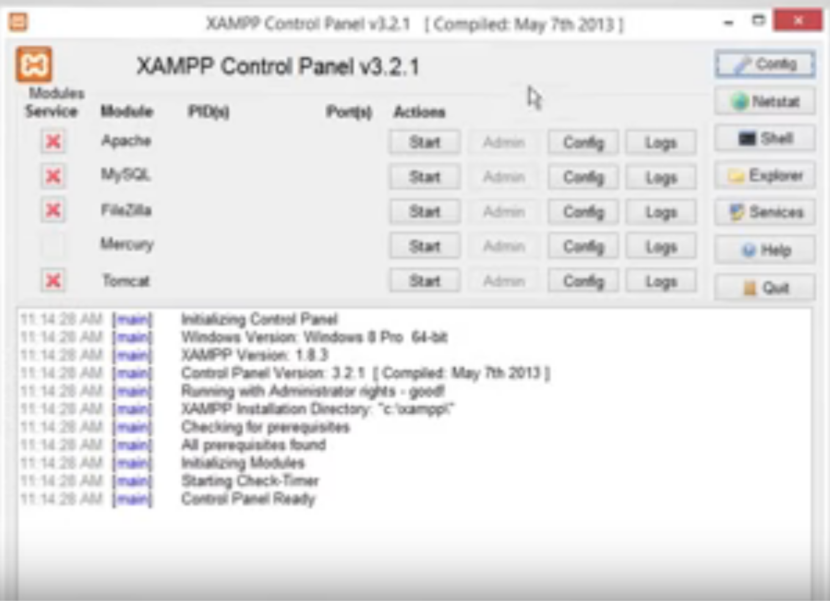
XAMPP
“XAMPP is a completely free, easy to install Apache distribution containing MariaDB, PHP, and Perl. The XAMPP open source package has been set up to be incredibly easy to install and to use.”
XAMPP on a USB Stick
https://portableapps.com/apps/development/xampp
https://willtan.com/installing-xampp-on-usb-flash-drive/
https://www.apachefriends.org/index.html

Slide 58
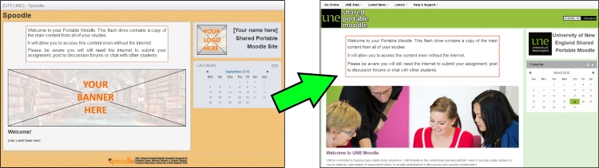
Moodle on a Stick
“Spoodle is an up to date portable moodle / ‘moodle on a stick’ solution for learners to access Moodle courses without requiring constant internet access.”
https://moodle.org/mod/forum/discuss.php?d=342367
https://www.youtube.com/watch?v=EsHEgSYKr4A

Slide 59
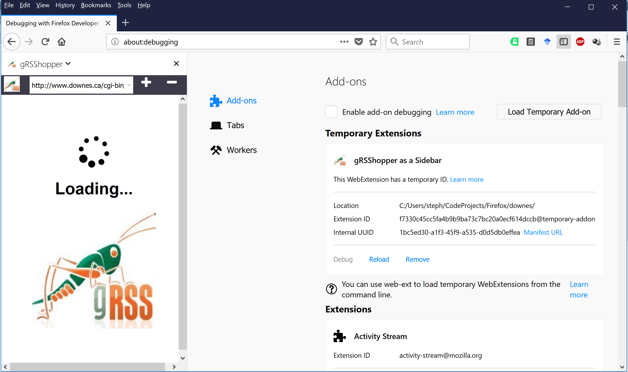
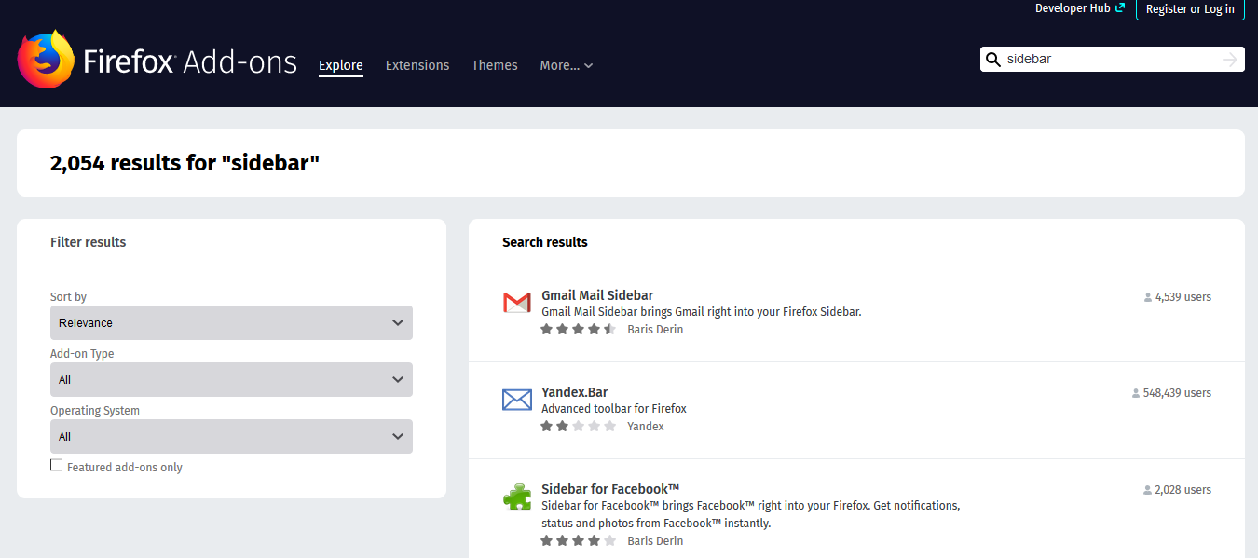
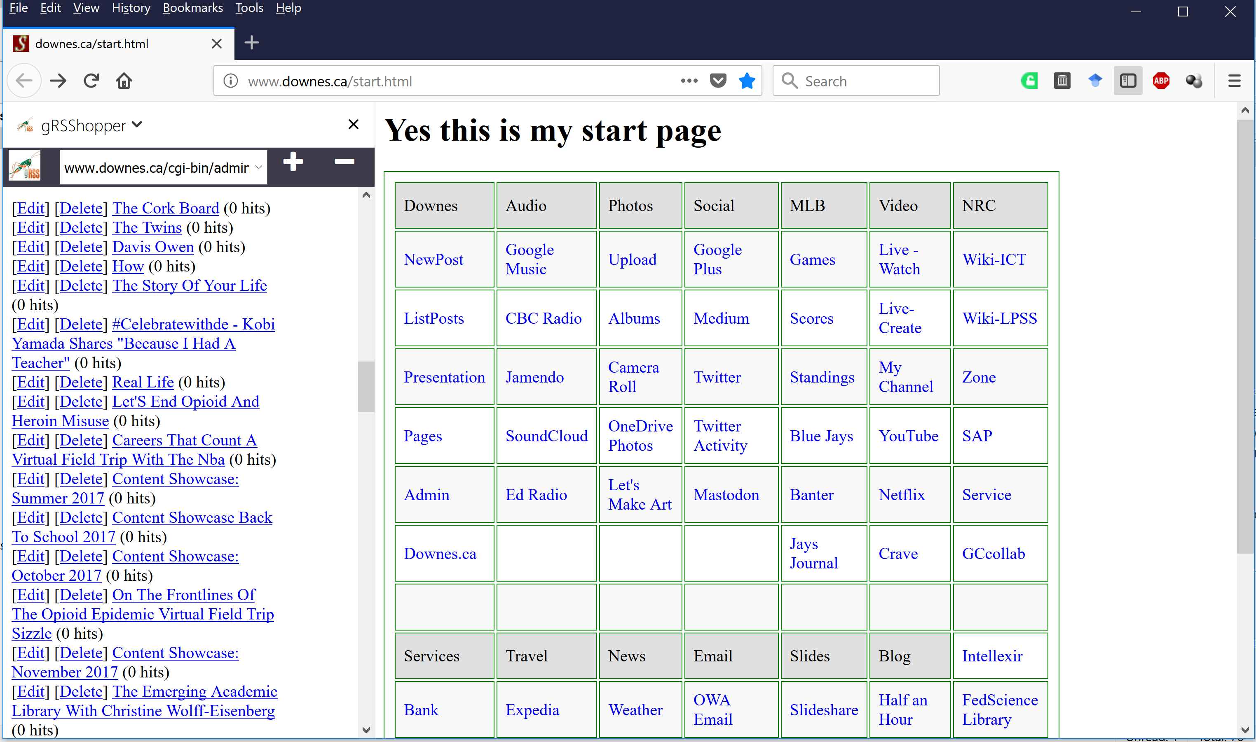
Embedding Applications in Other Applications
gRSShopper as a Firefox Sidebar
https://addons.mozilla.org/en-US/firefox/search/?q=sidebar&platform=WINNT&appver=58.0

Slide 60
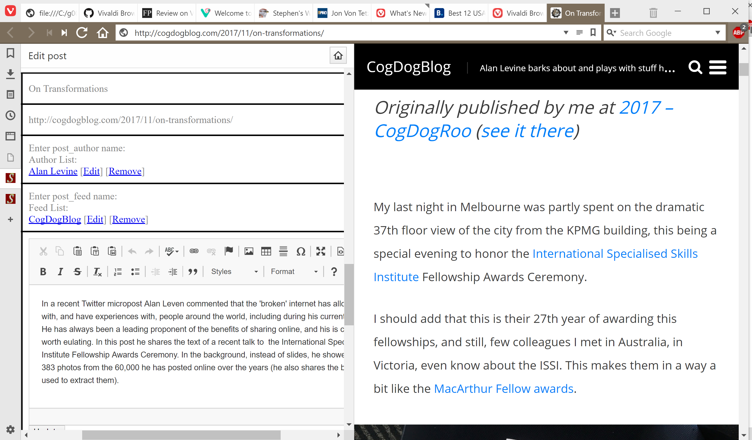
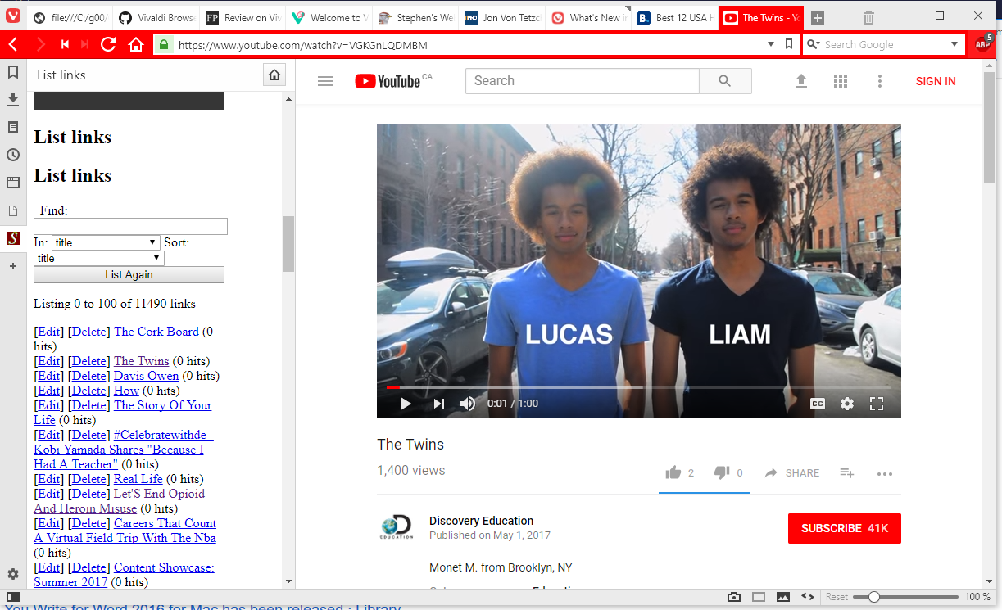
Embedding Applications in Other Applications
gRSShopper in Vivaldi
https://vivaldi.com/

Slide 61


Embedding Applications in Other Applications
Research and References in an MS-Word Plugin
https://www.officetooltips.com/office_2013/tips/advanced_research_with_research_pane.html

Slide 62

Server Virtualization
Parallels - https://www.parallels.com/
VMWare - https://www.vmware.com/
Virtual Box - https://www.virtualbox.org/
Hyper-V - https://docs.microsoft.com/en-us/virtualization/hyper-v-on-windows/quick-start/enable-hyper-v

Slide 63


Virtualization Platforms - Vagrant
https://www.vagrantup.com/

Slide 64


Loading and Running Vagrant Boxes
Scotch Box
  https://box.scotch.io/ -- http://192.168.33.10/
  WPDistillery - https://wpdistillery.org/ - for WordPress
Homestead
  Instructions - https://laravel.com/docs/5.5/homestead#first-steps

Slide 65



Docker

Slide 66


Canvas on Docker
https://github.com/instructure/canvas-lms/blob/master/script/docker_dev_setup.sh
http://slides.com/jamesluker/how-to-docker-2#/

Slide 67


Big Blue Button in Docker
http://docs.bigbluebutton.org/labs/docker.html
https://hub.docker.com/r/bigbluebutton/bigbluebutton/

Slide 68


Moodle on Docker
https://hub.docker.com/r/jauer/moodle/

Slide 69

Options
https://bitnami.com/stack/moodle/containers

Slide 70






Cloud Infrastructure Providers
AWS – Amazon - https://aws.amazon.com/
Azure – Microsoft - https://azure.microsoft.com
Bluemix – IBM Cloud - https://www.ibm.com/cloud/
Google Cloud Platform - https://cloud.google.com/
Oracle Cloud - https://cloud.oracle.com/
https://www.srgresearch.com/articles/microsoft-google-and-ibm-charge-public-cloud-expense-smaller-providers

Slide 71


Cloud Computing for Education
Amazon Web Services - https://aws.amazon.com/education/

Slide 72

OER and Virtualization
Open Distribution of Virtual Containers as a Key Framework for Open Educational Resources and STEAM Subjects Alberto Corbi and Daniel Burgos
http://www.ejel.org/issue/download.html?idArticle=575
“Unikernels represent and deeper simplification of the virtual container approach, given that all necessary computing elements (operative system kernel, basic libraries, frameworks, drivers, scientific application, etc.)”

Slide 73

Big Idea 2: Course(?) in Containers
Tools that enable cloud-on-demand applications and services
https://www.techradar.com/news/what-is-container-technology
gRSShopper in a Box
https://www.downes.ca/presentation/482

Slide 74

Re-Decentralizing the Web
Containers
Notes:
Re-decentralizing the Web, for good this time
Ruben Verborgh, Ghent University – imec – IDLab
11 January 2019
https://ruben.verborgh.org/articles/redecentralizing-the-web/
Challenges and Opportunities for use of Social Media in Higher Education
Terry Anderson, Journal of Learning for Development, 2019/04/23
https://jl4d.org/index.php/ejl4d/article/view/327/361

Slide 75

Decentralized Data and Service Providers
Centralized applications compete in a single market, based on data ownership. On a decentralized Web, data and service providers compete in different markets.
Notes:
Re-decentralizing the Web, for good this time
Ruben Verborgh, Ghent University – imec – IDLab
11 January 2019
https://ruben.verborgh.org/articles/redecentralizing-the-web/

Slide 76
Decentralized Data and Service Providers
Centralized applications compete in a single market, based on data ownership. On a decentralized Web, data and service providers compete in different markets.
Notes:
Re-decentralizing the Web, for good this time
Ruben Verborgh, Ghent University – imec – IDLab
11 January 2019
https://ruben.verborgh.org/articles/redecentralizing-the-web/

Slide 77

Decentralized Social Networks
Solid
IndieWeb
Mastodon
MeFi
ActivityPub
https://www.w3.org/TR/activitypub/
https://solid.mit.edu/
Notes:
“Solid”. (n.d.). , available at: https://solid.mit.edu/.
Berners-Lee, T. (2006), “Linked Data”, 27 July, available at: https://www.w3.org/DesignIssues/LinkedData.html.
Berners-Lee, T. and O’Hara, K. (2013), “The read–write Linked Data Web”, Philosophical Transactions of the Royal Society A, Vol. 371 No. 1987.
Image: http://blog.economie-numerique.net/2018/11/08/solid-le-projet-ambitieux-de-tim-berners-lee-linventeur-dinternet/

Slide 78
Activity
Instructions
Create a demo account at a cloud service like https://cloud.digitalocean.com
Use the demo account to create an instance of WordPress
Log in to your Word Press account and create a new post
Optional - subscribe to your new blog

Slide 79

Graph

Slide 80

Graph
When we connect things together we have created a graph. A graph has two types of component: the entities being connected (sometimes called nodes), and the connections between those entities (sometimes called edges).

Slide 81

Web3
Web3 is to a large degree a reaction against centralization
Eg. IPFS, IPLD, dat://
http://whatdoesthequantsay.com/2015/09/13/ipfs-introduction-by-example

Slide 82

Graph as the conceptual basis for web3 networks
Graph connects all the resources across these services using relationships.
Graph Data Connect provides a way to interact with the data that's available through the Graph APIs.
https://docs.microsoft.com/en-us/graph/overview
Notes:
https://developer.microsoft.com/en-us/graph/docs/concepts/overview

Slide 83

Big Idea 3: Graph, Not Story
Narrations and models focus on common or ‘best’ practices
Graphs capture patterns, outliers, and the unexpected.
Knowledge is recognition, not remembering
Notes:
https://ontotext.com/linked-open-data-cultural-heritage/
https://www.w3.org/wiki/LinkedData
https://www.w3.org/wiki/SweoIG/TaskForces/CommunityProjects/LinkingOpenData
https://communitywiki.org/wiki/MachineCodeBlocks (Lion Kimbro, 2005ish)

Slide 84

The types of questions graph analytics answer
Investigate the route of a disease or a cascading transport failure.
Uncover the most vulnerable, or damaging, components in a network attack.
Identify the least costly or fastest way to route information or resources.
https://neo4j.com/graph-algorithms-book/
Notes:
Graph Algorithms: Practical Examples in Apache Spark and Neo4j
Mark Needham, Amy E. Hodler, O'Reilly, 2019/04/23
https://neo4j.com/graph-algorithms-book/
• Investigate the route of a disease or a cascading transport failure.
• Uncover the most vulnerable, or damaging, components in a network attack.
• Identify the least costly or fastest way to route information or resources.
• Predict missing links in your data.
• Locate direct and indirect influence in a complex system.
• Discover unseen hierarchies and dependencies.
• Forecast whether groups will merge or break apart.
• Find bottlenecks or who has the power to deny/provide more resources.
• Reveal communities based on behavior for personalized recommendations.
• Reduce false positives in fraud and anomaly detection.
• Extract more predictive features for machine learning.

Slide 85
More
A Gentle Introduction To Graph Theory. Vaidehi Joshi. https://medium.com/basecs/a-gentle-introduction-to-graph-theory-77969829ead8
The Neural Network Zoo. Fjodor van Veen. Neural Networks are types of graphs. http://www.asimovinstitute.org/neural-network-zoo/
Graph Data Structure And Algorithms. This page has a very brief description of a graph data structure and then a long list of things that can be done with graphs - cycling, sorting, spanning, searching. https://www.geeksforgeeks.org/graph-data-structure-and-algorithms/
GQL Is Now a Global Standards Project alongside SQL. https://gql.today/
Social Network Analysis. Philip Leifeld. http://www.bearnetwork.ca/wp-content/uploads/2018/10/slides-leifeld-bear.pdf

Slide 86
Activity
Instructions
Create a model graph of some aspect of this workshop (it doesn't have to be an actual graph, only a representation of what an actual graph might look like. We've already seen, eg., graphs on the relations between people in the workshop. Could there be other types of graphs?
In your model, consider how the states of the entities in that graph might vary. Consider not only how nodes might vary (eg., a person might have a different height over time) but also how the edges might vary (eg., a person might have a different strength of relation (calculated how?) with another person over time).
In your model, consider how knowledge about the changes in states in the graph might be used.
Create your graph using an online service like https://www.draw.io/ - of if you prefer, use the space below (note that you will need to specify a cloud account to store your graph when you use draw.io )

Slide 87

Resources

Slide 88

Resources
Learning resources have traditionally been things like textbooks and media, but now learning resources can be anything from video to virtual reality to application. How we describe these, and access them, is changing.

Slide 89

Directed Acyclic Graph (DAG)
Used to create collections of related data elements
https://en.wikipedia.org/wiki/Directed_acyclic_graph

Slide 90

GitHub
Version control in a DAG
https://lukeluo.blogspot.com/2014/06/git-as-i-understand-4-working.html

Slide 91

A Distributed GitHub for Learning Resources
Creativity happens in a context, in a community, where building on each other’s work and sharing is the norm
https://github.com/topics/educational-materials
https://github.blog/2015-09-22-teachers-manage-your-courses-with-classroom-for-github/

Slide 92

From semantics to cryptography
The transition: the Merkle graph
https://www.slideshare.net/quipo/nosql-databases-why-what-and-when/91-Merkle_Trees_Hash_Trees_Leaves

Slide 93

Hashgraphs and Merkle Chains
https://www.blockchainappfactory.com/blog/dag-vs-blockchain-vs-hashgraph/

Slide 94

Hash Addresses
Each piece of content has a unique address, which is a hash of its content
https://ipfs.io/ipfs/QmXoypizjW3WknFiJnKLwHCnL72vedxjQkDDP1mXWo6uco/wiki/Distributed_hash_table.html

Slide 95

4.4 IPFS - IPLD
IPFS white paper: IPFS - Content Addressed, Versioned, P2P File System (DRAFT 3).
PFS consists of a network of peer-to-peer nodes (aka computers that talk to each other directly)
These nodes can store content (any type of file)
Content is represented by a hash and is immutable (if the content changes, so does the hash) - In the case of IPFS, the key of the distributed hash table is a hash over the content.
IPLD - Inter Planetary Linked Data
IPLD website (Inter Planetary Linked Data) - https://ipld.io/
the IPLD specs and the IPLD implementations.
Hosting a website on IPFS - https://ipfs.io/ipfs/QmdPtC3T7Kcu9iJg6hYzLBWR5XCDcYMY7HV685E3kH3EcS/2015/09/15/hosting-a-website-on-ipfs/
https://whatdoesthequantsay.com/2015/09/13/ipfs-introduction-by-example

Slide 96
Big Idea 4: CARE
CARE is based on the idea of distributed hashgraph networks
A lot like Git http://www.gthub.com
https://www.youtube.com/watch?v=QNKpK_InQHQ

Slide 97




Content Addressable Resources for
Education
The new OER
https://ipfs.io/

Slide 98
Open educational resources in the future
Each piece of content has a unique hash address
OER will be more like tools that students use in order to create their own learning
The learning happens through the use of the content.
Licensing fades to the background
Most resources are created and used only once.
The resource taps into current data and may be localized or adapted to the content consumer.
Technologies such as encryption, hashing and blockchain create a record of ownership and provenance of any resource.

Slide 99

Cognii – SquirrelAI – Magpie – X5GON
Cognii Virtual Learning Assistant engages a student in a chatbot-style learning conversation by prompting them to construct an answer, giving them instant formative assessment - http://cognii.com/
Squirrel AI - pure-play AI-powered adaptive education provider in China… provides personalized and high-quality K-12 after-school tutoring - http://squirrelai.com/
magpie recommends high-quality content and integrates with your learning systems - starts with a configurable chatbot conversation - prioritises most relevant content for each user. https://learn.filtered.com/magpie
X5GON.org – fully automated creation of OER courses - https://www.x5gon.org/follow/oer/

Slide 100

AI-Generated Music
MuseNet, " a deep neural network that can generate 4-minute musical compositions with 10 different instruments, and can combine styles from country to Mozart to the Beatles.“
Relentless Doppelganger, the Bot Prownies, who produce an almost-acceptable brand of punk. If you prefer guitar metal, Coditany of Timeness might be more to your taste. Not quite as successful is Evolution 22 by Deep the Beatles. For something a little softer (and quite good) try On the Edge, by AIVA. AIVA also does a nice classical tune or movie score. Need royalty-free music for your videos? Try JukeDeck (a little too house for my tastes). Taryn Southern, meanwhile, uses an AI to compose the music, then adds her own lyrics and vocals - her song Break Free is quite nice.
Notes:
MuseNet
Christine Payne, OpenAI, 2019/04/26
Icon
https://openai.com/blog/musenet/

Slide 101
More
OER World Map. A couple years or so ago UNESCO launched an OER mapping project. https://oerworldmap.org/
Introducing the Dweb. Dietrich Ayala. The “d” in “dweb” usually stands for either decentralized or distributed. https://hacks.mozilla.org/2018/07/introducing-the-d-web/
Distributed Hash Table. Type of decentralized distributed system. https://ipfs.io/ipfs/QmXoypizjW3WknFiJnKLwHCnL72vedxjQkDDP1mXWo6uco/wiki/Distributed_hash_table.html
Beaker. Beaker brings peer-to-peer publishing to the Web. https://beakerbrowser.com/
A Look at the Future of Open Educational Resources. https://www.ijoer.org/a-look-at-the-future-of-open-educational-resources/

Slide 102
Activity
Instructions:
Offline activity: design a scenario where students could obtain content or data, revise or remix that content or daya, and create a new learning resource for their own use.
Online activity:
  Create an account at GitHub and Create a new repository - https://github.com
  Create some content for your repository
  Practice sharing your repository with others, and cloning other’s repositories
Bonus: try downloading and using the Beaker browser

Slide 103

Identity

Slide 104

Identity
In this workshop we look at identity relatively narrowly, asking how we know who someone is, how we project ourselves on the internet, and how we can be safe and secure.

Slide 105

Identity
In social networks, we were the product – what about now?
https://thepsychologist.bps.org.uk/volume-30/may-2017/caution-identity-under-construction

Slide 106

An end to passwords
(and even to two-factor authentication)
https://www.channelfutures.com/business-models/new-guidelines-end-frequent-password-changes

Slide 107

Symmetric vs Asymmetric Keys
https://www.thesslstore.com/blog/difference-asymmetric-encryption-algorithms-vs-symmetric-encryption-algorithms/

Slide 108

Big Idea 5: We are the Content
McLuhan: The Content is the Audience
https://www.youtube.com/watch?v=QNKpK_InQHQ

Slide 109

Self-Sovereign Identity
https://medium.com/@carrascosa.cobos/will-europe-aim-for-digital-identity-796afa3ce6cd

Slide 110

Identity Graph
https://twitter.com/merkle/status/938123229335613440
Notes:
Instead of demographics being about quantity (sales charts, votes in elections and polls, membership in community) we will now have access to a rich tapestry of data and relations. Instead of grades or scores (or hit counts, or followers) our self-assessments will be based on the quality of the experience, the depth of the insight, or the richness of the interaction. The “quantified self” will give way to the “qualified self” (here, and here)

Slide 111
More
Identity Graphs: how online trackers follow you across devices. Robert Heaton. https://robertheaton.com/2017/11/24/identity-graphs-how-online-trackers-follow-you-across-devices/
What Is Identity? OpenLearn. Read through the first part of this short course. https://www.open.edu/openlearn/people-politics-law/politics-policy-people/sociology/identity-question/content-section-1.1
Identity as Evolving, Dynamic, Contextual. Maha Bali. https://blog.mahabali.me/writing/identity-as-evolving-dynamic-contextual-el30/
Keybase.io - Downes. This is my Keybase page. https://keybase.io/downes
The Basics of Decentralized Identity. Kames. https://medium.com/uport/the-basics-of-decentralized-identity-d1ff01f15df1
Decentralized Identifiers. A new World Wide Web Confortium (W3C) specification. https://w3c-ccg.github.io/did-spec/

Slide 112
Activity
Instructions
Create an Identity Graph: We are expanding on the marketing definition of an identity graph. It can be anything you like, but with one stipulation: your graph should not contain a self-referential node titled ‘me’ or ‘self’ or anything similar
  Think of this graph as you defining your identity, not what some advertiser, recruiter or other third party might want you to define.
  Don't worry about creating the whole identity graph - focusing on a single facet will be sufficient. And don't post anything you're not comfortable with sharing. It doesn't have to be a real identity graph, just an identity graph, however you conceive it.

Slide 113

Recognition

Slide 114

Recognition
How do we know a course has been successful? How do we know what someone has learned? How can we know whether to trust in the education of our mechanics, doctors, engineers and pilots.

Slide 115

Measuring activities
xAPI and the Learning Record Store
https://xapi.com/overview/

Slide 116

What counts as success?
Competencies?
https://www.pearson.com/us/higher-education/products-services-institutions/career-success-program.html

Slide 117



Competencies and Skills
Competency & Skills System (CaSS). Advanced Distributed Learning. https://adlnet.gov/projects/cass
Disaggregation of the traditional degree, breaking it into component parts (Horizon Report). “To be profitable privatisation depends on standardisation to scale.” (We The Educators). Credentials earn careers, but competencies earn gigs.

Slide 118

Badges, Microcredentials…
Open Badges are the global standard for verifiable digital credentials.
https://openbadges.org/ https://openbadgefactory.com/
https://www.openbadges.me/ https://badgr.com/

Slide 119


Badges and Blockchain
Doug Belshaw: "If we used the blockchain for Open Badges, then we could prove beyond reasonable doubt that the person receiving badge Y is the same person who created evidence X.” Sony plans to launch a testing platform powered by blockchain and that IBM plans to offer 'blockchain-as-a-service.'
Notes:
http://dmlcentral.net/blog/doug-belshaw/peering-deep-future-educational-credentialing
http://www.downes.ca/search/blockchain
https://bitcoinmagazine.com/articles/ibm-deploys-blockchain-as-a-service-announces-initiatives-to-make-the-blockchain-ready-for-business-1455726071/
https://techcrunch.com/2016/02/22/sony-is-building-an-education-and-testing-platform-powered-by-the-blockchain/
http://hackeducation.com/2016/02/25/blockchain-edu1

Slide 120

Activity Records, xAPI…
xAPI lets you capture (big) data on human performance, along with associated instructional content or performance context information…
https://adlnet.gov/research/performance-tracking-analysis/experience-api/
https://www.yetanalytics.com/xapi-lrs

Slide 121


Learning Analytics
Siemens and Long
- Course-level: learning trails, social network analysis, discourse analysis
- Educational data-mining: predictive modeling, clustering, pattern mining
- Intelligent curriculum: semantically defined curricular resources
- Adaptive content: content sequence based on behavior, recommendation
- Adaptive learning: social interactions, learning activity, learner support
Notes:
https://er.educause.edu/articles/2011/9/penetrating-the-fog-analytics-in-learning-and-education
http://quantifiedself.com/
Predictive Analytics - eg. SmartKlass https://moodle.org/plugins/local_smart_klass
Recognition Tasks – eg. Learning Analytics enriched rubrics - https://docs.moodle.org/30/en/Learning_Analytics_Enriched_Rubrics
See also: http://www.vteducation.org/en/articles/learner-data/introduction-learning-analytics

Slide 122

Analytics and Big Data
Facebook
Twitter
EdX
Coursera
YouTube
Blackboard
Email
etc
Shallow
Tells us about the platform
Deep
Tells us about the person

Slide 123

Personal Learning Record
Stuff Goes Out
Stuff Comes In
Learning Activities
I read and watch stuff
I play with toys
I make stuff
Things, Properties, Relations
Things I did
Stuff I make
Big stuff goes here
Me
Questions
Personal Library
Pictures
Books
Movies
Answers
Learning Analytics Services

Slide 124
Personal Learning Record
This is a new type of data – it’s called the personal graph.
Each person has their own private personal graph.
The PLR contains all a person’s learning records, including:
certificates, badges and credentials
activity records, test results, scores
Assignments, papers, drawings, things they create
Me

Slide 125

Identity and Recognition
The quantified self will give way to the qualified self
http://quantifiedself.com/reporter-app/

Slide 126

The Qualified Self
Will the ‘connected self’ be more reflective? Will ‘the connective self’ more honestly reflect our hopes, aspirations and dreams?
https://jennymackness.wordpress.com/tag/digital-identity/
https://mitpress.mit.edu/books/qualified-self
https://markcarrigan.net/2014/07/23/qualitative-self-tracking-and-the-qualified-self/
Notes:
Jwnny Mackness: The connected self will be more about our relations and interactions. Will this lead to a more ethical Web? Will digital identity as a ‘connected self make the ‘source of truth’ of these identities more visible? Will the ‘connected self’ be more reflective? Will ‘the connective self’ more honestly reflect our hopes, aspirations and dreams?

Slide 127
Big Idea 6: AI-Based Learning Recognition
What happens when we recognize skills and competencies rather than content knowledge?
We no longer need to depend on tests and exams and can instead rely on a body of work.
Notes:
https://www.pearson.com/us/higher-education/products-services-institutions/career-success-program.html

Slide 128

Recognizing Learning as a Totality of Achievement
We can also gather data outside the school or program, looking at actual results and feedback from the workplace.
https://www.cdc.gov/chronicdisease/resources/publications/aag/workplace-health.htm

Slide 129
More
China’s Social Credit System: A Mark of Progress or a Threat to Privacy? https://piie.com/publications/policy-briefs/chinas-social-credit-system-mark-progress-or-threat-privacy
Open Badges. General information page about badges. https://openbadges.org/
An Experience API for learning everywhere (also in virtual worlds). Roland Legrand. https://www.mixedrealities.com/2018/10/25/an-experience-api-for-learning-everywhere-also-in-virtual-worlds/
2018 Technical Report on xAPI. IEEE LTSC TAGxAPI. https://www.tagxapi.org/ieee-technical-report/

Slide 130
Activity
Instructions
If you have internet access, create a free account on a Badge service (https://badgr.com/ , https://www.openbadges.me/ , https://openbadgefactory.com/ ). Otherwise, use this space to design your badge, clearly identifying different data elements:
  create a badge and give it a name, criteria, design
  award it to yourself or describe how it would be awarded.
  use a blog post on your blog as the 'evidence' for awarding yourself the badge
  place the badge on the blog post.

Slide 131

Community

Slide 132

Community
The fundamental challenge to community is to make decisions on matters affecting everybody while leaving to individuals, companies and institutions those matters not effectively managed by consensus.

Slide 133

The Byzantine Generals Problem
How to find the ‘source of truth’ in a world filled with bad actors and unknown quantities
Trust no one…
https://slideplayer.com/slide/5163640/

Slide 134

Distributed ledgers
“A distributed ledger technology (DLT) is a system where we share information and we don’t trust each other individually, but we trust the group as a whole. DLTs allow us to come up with a consensus on the order of transactions and timestamps.”
https://hackernoon.com/an-overview-of-hashgraph-b0900a1fd7bf

Slide 135

Construction of a blockchain
https://hackernoon.com/how-does-blockchain-technology-work-ceeeee47eaba

Slide 136

Consensus – Proof of Work
“The best known and most widely deployed mechanism is of course proof-of-work (aka. Nakamoto consensus). Forks can occur, and are resolved by PoW consensus, which amounts to picking the chain with the most accumulated work.”
https://blog.acolyer.org/2018/02/12/sok-consensus-in-the-age-of-blockchains/

Slide 137

Consensus - Alternatives
https://www.deviantart.com/azza1070/art/Blockchain-Protocols-PoB-PoW-PoS-PoI-PoC-PoA-734159319
ConsensusPedia: An Encyclopedia of 30 Consensus Algorithms. Consensus algorithms are the basis of all the blockchains/DAGs. https://hackernoon.com/consensuspedia-an-encyclopedia-of-29-consensus-algorithms-e9c4b4b7d08f
Notes:
https://www.onecommunityglobal.org/consensus-and-decision-making-lesson-plan/

Slide 138

Blockchain-based protocol for autonomous business activity
Example
Typical work scenario of Drone Employee. Dashed arrows indicate waiting of contract appearance. A set of all contracts in the network are integrated into decentralized market block.
Blockchain-based protocol of autonomous business activity for multi-agent systems consisting of UAVs. Available from: https://www.researchgate.net/publication/325451400_Blockchain-based_protocol_of_autonomous_business_activity_for_multi-agent_systems_consisting_of_UAVs [accessed Apr 28 2019].
Notes:
(PDF) Blockchain-based protocol of autonomous business activity for multi-agent systems consisting of UAVs. Available from: https://www.researchgate.net/publication/325451400_Blockchain-based_protocol_of_autonomous_business_activity_for_multi-agent_systems_consisting_of_UAVs [accessed Apr 28 2019].

Slide 139

Truffle (NRC example)
a development framework for Ethereum - http://truffleframework.com/
  Truffle takes care of managing your contract artifacts so you don't have to.
  Ganache - https://truffleframework.com/ganache - one-click blockchain
  Drizzle- A collection of front-end libraries that make writing dapp user interfaces easier and more predictable.
https://www.slideshare.net/MartinKppelmann/build-dapps-13-dev-tools

Slide 140

Big Idea 7: Community as Consensus
Notes:
No longer based on sameness…
Now based on making decisions together…
On consensus
https://www.onecommunityglobal.org/consensus-and-decision-making-lesson-plan/

Slide 141
Creating Community
The mechanisms we use to interact and reach consensus are what define us as a community…
Is consensus based in work, stake, importance, authority…? What are the conditions for consensus?
Paxos https://en.wikipedia.org/wiki/Paxos_(computer_science)

Slide 142
More
Trust, Truth, Consensus and Community on the distributed web - Jenny Mackness - https://jennymackness.wordpress.com/2018/12/09/trust-truth-consensus-and-community-on-the-distributed-web/
How Does Distributed Consensus Work? Preethi Kasireddy. Distributed systems and consensus. https://medium.com/s/story/lets-take-a-crack-at-understanding-distributed-consensus-dad23d0dc95
What is Blockchain? Lucas Mostazo, YouTube. Blockchain explained in plain English. https://www.youtube.com/watch?v=3xGLc-zz9cA
Education Blockchain Market Map. HolonIQ. https://www.holoniq.com/blockchain

Slide 143
Activity
Instructions
As a community, create an assignment the completion of which denotes being a member of the community. For the purposes of this task, there can only be one community for the entire workshop.
Use the space above to contain your contribution to the community.
For each participant, your being a member of the community completes the task.
Note: in the workshop, you will be presented with the ‘Byzantine Generals Problem’ and left to consider how you, as a community of communities, might solve it.

Slide 144

Experience

Slide 145

Experience
It is a truism that we learn from experience, and yet creating a role for experience in learning has been one of the most difficult problems in education. And so much of education continues to rely on indirect methods depending on knowledge transfer - reading, lectures, videos - rather than hands-on practice and knowledge creation.

Slide 146

A Basis in Personal Experience
Truth begins with personal knowledge…
We can describe how it works in a specific domain
https://partiallyexaminedlife.com/2018/08/06/ep196-1-simon-blackburn/
https://halfanhour.blogspot.com/2016/12/detecting-fake-news.html

Slide 147


Practice and Reflection
We learn from experience…
And reflecting on experience. We are beginning to combine the experience and reflection
https://charles-jennings.blogspot.com/2016/07/the-power-of-reflection-in-ever.html
https://www.epicgames.com/fortnite/en-US/home

Slide 148

Content and Creation
Creation of the content is becoming a part of the content itself.
Livecaster
Twitch
Open Broadcaster
https://intrsection.com/2017/04/8396/
https://www.twitch.tv/
https://obsproject.com/

Slide 149

High School Math ML Problem
Here we have a case where a high school student has been given the problem of optimizing traffic flow in his school parking lot.
When they’re in trafic, it’s not about what you want to teach them, it’s about what they need to know; it’s not about what you can do for them, it’s about what they can do for themselves
https://www.reddit.com/r/MachineLearning/comments/bhp6bw/p_can_you_solve_this_high_school_ml_problem/
Notes:
Can you solve this High School ML problem?
LittleLouis, Reddit, Apr 27, 2019
https://www.reddit.com/r/MachineLearning/comments/bhp6bw/p_can_you_solve_this_high_school_ml_problem/

Slide 150

Creating With OpenAI
http://dogtrax.edublogs.org/2019/05/18/writing-collaboration-with-openai-context-and-constraints/
Notes:
Ultimately, our learning resource will be created as needed by artificial intelligence – as learners we will work with AI to create these resources and share them on CAENet for future use by other AIs
AI generated patent claims - https://aipatent.wordpress.com/
AI in application development - https://venturebeat.com/2019/05/20/microsoft-wants-to-apply-ai-to-the-entire-application-developer-lifecycle/

Slide 151

Big Idea 8: Content and Creation Combined
https://www.mediavillage.com/article/how-banksys-disruptive-approach-informs-the-best-creative-campaigns/

Slide 152

CodePen
https://codepen.io/picks/pens/
https://codepen.io/caraujo/pen/LVPzxO

Slide 153

New types of learning resources​
Jupyter Notebook combines data and code in a document
JupyterLab Environment - work with code, data, and the Jupyter notebook format.
https://jupyter.org/try (Binder demo)
https://www.dataquest.io/blog/jupyter-notebook-tips-tricks-shortcuts/
Notes:
https://developers.arcgis.com/python/guide/using-the-jupyter-lab-environment/
https://noteable.edina.ac.uk/ - Computational notebooks allow you to create and share live code, equations, visualisations and explanatory text. Noteable is a bespoke cloud-based application that lets students and lecturers run Jupyter notebooks online.

Slide 154

Notebooks
Jupyter Notebook combines data and code in a document
JupyterLab Environment - work with code, data, and the Jupyter notebook format.
https://www.dataquest.io/blog/jupyter-notebook-tips-tricks-shortcuts/
Notes:
See also: OpenLearn Jupyter Books Remix, TM351 Notebooks in VM and Electron.

Slide 155


A gallery of interesting Jupyter Notebooks
https://github.com/jupyter/jupyter/wiki/A-gallery-of-interesting-Jupyter-Notebooks#machine-learning-statistics-and-probability

Slide 156

Cretivity and Consensus
Workplaces, are beginning to create self-organizing consensus-based co-production networks.
https://www.sciencedirect.com/science/article/pii/S000368701630093X

Slide 157

Jupytext – Notebook plus version control
Jupytext saves two (synced) versions of your notebook. A .ipynb file and a .py file. (Other formats are possible as well.) Y
https://github.com/mwouts/jupytext

Slide 158

Creating and learning – code and outcome - combine in a single environment​
This is simulated circuitry that can compute as you watch. The switches on the left turn the current on and off at random, and the logic gates direct the flow of the current.
https://www.bloomberg.com/graphics/2015-paul-ford-what-is-code/

Slide 159

Agency

Slide 160

Agency
This part of the workshop addresses two conceptual challenges: first, the shift in our understanding of content from documents to data; and second, the shift in our understanding of data from centralized to decentralized.

Slide 161

Agency: What is It?
The relative standing of the individual with respect to community, institutions, and governments
Self-Efficacy
Self-efficacy refers to an individual's belief in his or her capacity to execute behaviors necessary to produce specific performance attainments (Bandura, 1977, 1986, 1997). Self-efficacy reflects confidence in the ability to exert control over one's own motivation, behavior, and social environment.
https://opentextbc.ca/introductiontosociology/chapter/chapter17-government-and-politics/
https://www.apa.org/pi/aids/resources/education/self-efficacy
Image: https://www.emotivebrand.com/agency-of-the-future/

Slide 162

Agency Changes
Agency changes as technology changes
Agency is based on affordances
https://www.tcd.ie/Geography/assets/pdf/env_gov/Hynes_2013_practices_of_technology.pdf

Slide 163

You’re Not Stuck In Traffic, You Are Traffic
“a new generation of designers has emerged, concerned with designing strategies to subvert this “natural default-setting” in which each person understands themselves at the center of the world.”
https://jods.mitpress.mit.edu/pub/design-as-participation
Notes:
Design as Participation
Kevin Slavin, Journal of Design and Science, 2019/04/29
https://jods.mitpress.mit.edu/pub/design-as-participation

Slide 164

Big Idea 9: Redefining Success
Four key outcomes for a modern distributed learning environment: security, identity, voice and opportunity.
https://www.downes.ca/post/68088
https://opentextbc.ca/introductiontosociology/chapter/chapter17-government-and-politics/

Slide 165


Agency
Education must focus on the tools and capacities for agency
https://www.globalpartnership.org/blog/building-peace-through-education
https://science.sciencemag.org/content/364/6441/702
Notes:
The hidden curriculum
The point of instruction-based learning is to learn how to be instructed
etc

Slide 166

Communities and Networks

Slide 167

Future Directions: Personalization
“Personalized learning refers to instruction in which the pace of learning and the instructional approach are optimized for the needs of each learner. Learning objectives, instructional approaches, and instructional content (and its sequencing) may all vary based on learner needs… activities are meaningful and relevant to learners, driven by their interests, and often self-initiated.” (NEPC)
Notes:
Image: http://www.aggregage.com/personalization-explained
Reimagining the Role of Technology in Education: 2017 National Education Technology Plan Update https://tech.ed.gov/netp/

Slide 168


The State The Individual

Slide 169


The State The Individual

Slide 170

The State The Individual

Slide 171

The State The Network The Individual

Slide 172
Groups Networks

Slide 173



Groups Networks
SAMENESS
AFFINITY
Collectives
Communities
ONE WAY
MANY WAYS

Slide 174
Groups Networks
SAMENESS
AFFINITY
Collectives
Communities
ONE WAY
MANY WAYS
Metallic - Elemental
Organic - Biological
UNITY | DIVERSITY
COORDINATION | AUTONOMY
CLOSED | OPENNESS
DISTRIBUTIVE | INTERACTIVE
VISION
STATEMENT
SOMETIMES EVEN PURITY
MELTING POT
MIXTURES
SALAD BOWL

Slide 175
Groups Networks
SAMENESS
AFFINITY
Collectives
Communities
ONE WAY
MANY WAYS
Metallic - Elemental
Organic - Biological
UNITY | DIVERSITY
COORDINATION | AUTONOMY
CLOSED | OPENNESS
DISTRIBUTIVE | INTERACTIVE
VISION
STATEMENT
SOMETIMES EVEN PURITY
MELTING POT
MIXTURES
SALAD BOWL
LEADERS! COLLABORATION
GROUP VALUE
(= LEADER VALUE)
COOPERATION
EXCHANGE
MUTUAL VA:UE

Slide 176
Groups Networks
SAMENESS
AFFINITY
Collectives
Communities
ONE WAY
MANY WAYS
Metallic - Elemental
Organic - Biological
UNITY | DIVERSITY
COORDINATION | AUTONOMY
CLOSED | OPENNESS
DISTRIBUTIVE | INTERACTIVE
VISION
STATEMENT
SOMETIMES EVEN PURITY
MELTING POT
MIXTURES
SALAD BOWL
LEADERS! COLLABORATION
GROUP VALUE
(= LEADER VALUE)
COOPERATION
EXCHANGE
MUTUAL VA:UE
LOCK-IN
MEMBERSHIP / IN CAMERA
STANDARDS - JARGON
WALLS
CONNECTION
PERSPECTIVE / CONTEXT
BRIDGES

Slide 177

Groups Networks
SAMENESS
AFFINITY
Collectives
Communities
ONE WAY
MANY WAYS
Metallic - Elemental
Organic - Biological
UNITY | DIVERSITY
COORDINATION | AUTONOMY
CLOSED | OPENNESS
DISTRIBUTIVE | INTERACTIVITY
VISION
STATEMENT
SOMETIMES EVEN PURITY
MELTING POT
MIXTURES
SALAD BOWL
LEADERS! COLLABORATION
GROUP VALUE
(= LEADER VALUE)
COOPERATION
EXCHANGE
MUTUAL VA:UE
LOCK-IN
MEMBERSHIP / IN CAMERA
STANDARDS - JARGON
WALLS
CONNECTION
PERSPECTIVE / CONTEXT
BRIDGES
AKA
TRICKLE DOWN
BROADCAST
STARS AND GURUS
CENTRALIZED
POWER – POWER LAWS
CONVERSATION
DISTRIBUTED
DEMOCRACY (OR POST-DEMOCRACY)
KNOWLEDGE
EMERGES
RICH
KNOWLEDGE,
LIKE MONEY,
FLOWS FROM AUTHORITY
POOR

Slide 178


Groups Networks
SAMENESS
AFFINITY
Collectives
Communities
ONE WAY
MANY WAYS
Metallic - Elemental
Organic - Biological
UNITY | DIVERSITY
COORDINATION | AUTONOMY
CLOSED | OPENNESS
DISTRIBUTIVE | INTERACTIVITY
VISION
STATEMENT
SOMETIMES EVEN PURITY
MELTING POT
MIXTURES
SALAD BOWL
LEADERS! COLLABORATION
GROUP VALUE
(= LEADER VALUE)
COOPERATION
EXCHANGE
MUTUAL VA:UE
LOCK-IN
MEMBERSHIP / IN CAMERA
STANDARDS - JARGON
WALLS
CONNECTION
PERSPECTIVE / CONTEXT
BRIDGES
AKA
TRICKLE DOWN
BROADCAST
STARS AND GURUS
CENTRALIZED
POWER – POWER LAWS
CONVERSATION
DISTRIBUTED
DEMOCRACY (OR POST-DEMOCRACY)
KNOWLEDGE
EMERGES
RICH
KNOWLEDGE,
LIKE MONEY,
FLOWS FROM AUTHORITY
POOR

Slide 179
Two Approaches…
Content
Practice
Practice
Content

Slide 180
Two Approaches…
Defines an ideal state
Defines a desired state
Content
Practice
Practice
Content
TEST
TRY
Person tests you
Person helps you

Slide 181
Two Approaches…
Defines an ideal state
Defines a desired state
Content
Practice
Correction
Iteration
GAP
Practice
Content
Opport-unity
TEST
TRY
Person tests you
Person helps you

Slide 182
Library Environment
Defines an ideal state
Defines a desired state
Content
Practice
Affordances
Correction
Requirements
Iteration
GAP
Content
Opport-unity
Practice
TEST
TRY
Person tests you
Person helps you

Slide 183
Personalized Personal
We do for you You do for yourself
Defines an ideal state
Defines a desired state
Content
Practice
Affordances
Correction
Requirements
Iteration
GAP
Practice
Content
Opport-unity
TEST
TRY
Person tests you
Person helps you

Slide 184

Identity
We are the thread that runs through an otherwise disconnected set of data
https://www.datadoghq.com/blog/monitoring-kafka-performance-metrics/

Slide 185

Personal Learning Environments

Slide 186

Cedric Price
Cedric Price: "Price was designing not for the uses he wished to see, but for all the uses he couldn’t imagine.... As opposed to the 'user' of a building who is interacting with a smart thermostat, the participants in a building are engaged with one another."
Or as I like to say, we built a trillion-dollar communication system, and people use it to send cat pictures, and that's the beauty of it.
https://www.architectural-review.com/essays/reputations-pen-portraits-/cedric-price-1934-2003/10026650.article
Notes:
https://www.architectural-review.com/essays/reputations-pen-portraits-/cedric-price-1934-2003/10026650.article

Slide 187
gRSShopper workflow
Personal
Context
Article
Photograph
Video
Person
Author
Publisher
Organization
Job Opportunity
Competency
Cetrificate
Event
Location / Place
Time / Date
Email
RSS
OAI
Sharepoint
Facebook
Twitter
Monster
Government
Repositories
Desire2Learn
Coursera
EdX
etc
Parsing
Scraping
Analytics
etc
Storage
RELATIONS

Slide 188

The Personal Learning Environment
It’s personal and you carry it with you
It’s a network – we don’t put everything in one package, but develop an infrastructure that links relevant resources
Different types of things, not just courses: access to learning resources, calling cards and communication tools, credentials, permits and licenses

Slide 189

Manage social media accounts

Slide 190

Register for the course

Slide 191


Read resources while in my course

Slide 192

Listen to related audio feeds

Slide 193

Manage the resource database

Slide 194

Work with various data types

Slide 195

Make my personal learning record

Slide 196

Display my portfolio

Slide 197

Manage my newsletters

Slide 198

Chat with social media friends

Slide 199

Create and attend live meetings

Slide 200

Look for a job, contract, project…

